Slide 1
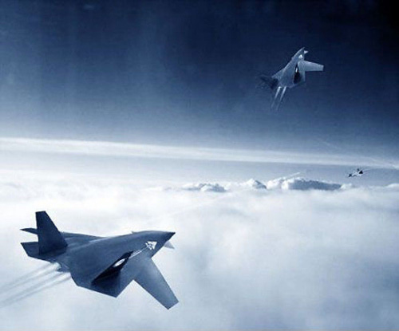
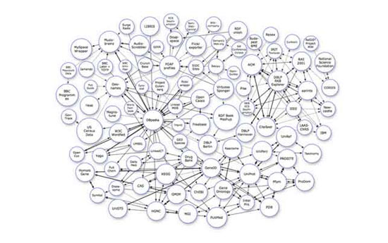
Welcome
to
Analysis and Design of Algorithms

Slide 2
Questions About 最优化问题
Concepts :
max(min) f(x), s.t. g_{i}(x)≤0|1≤i≤m
x : 目标变量, objective varible;
f : 目标函数, objective function;
g_{i} : 约束条件, constrained condition;
可行解: feasible solution, 满足m个约束条件的x;
最优解: optimal solution, 满足约束条件的, 且使函数f(x)最大(最小)化的变量x.

Slide 3
最优化方法
穷举法：exhausted enumeration;
数学规划：线性规划，非线性规划，整数规划；
分级处理：贪心法，动态规划；
确定性搜索：回溯法，分支限界法；
不确定性搜索：蒙特卡罗，随机逼近；
现代启发式搜索：模拟退火，进化算法，粒子群算法。

Slide 4
课堂练习
填空：
变治算法策略有 （ ） （ ）（ ） 。
结点间长度为k的路径条数可以利用 （哪种算法策略）实现的。
实例简化
表示改变
问题归约
变治策略
选择：
分治法也许是使用最广泛的算法设计方法，以下关于分治法的结论中正确的是()。
A．分治法能解决动态规划方法所能解决的任何问题
B．分治法找到的问题的解一定是最优解
C．用分治法能求出任何问题的解
D．分治法把大问题简单分解成一些较小的问题
D
动态规划解题思路：
首先确定子问题、状态变量和决策变量；
根据决策变量定义状态变量之间的状态转移方程；
写出求解变量的递推关系式；
定义表格，根据递推关系式，逐步使用最优决策及其相应的状态填表，得到最优解。

Slide 5
Recall:Optimization problems
Some Concepts:
Typical Methods:
  exhausted enumeration
  Mathematical programming
  Phased processing
  Searching
Optimization problems
  Dynamic programming, but overkill sometime.
  Greedy algorithm:
    Being greedy for local optimization with the hope it will lead to a global optimal solution, not always, but in many situations, it works.

Slide 6
课堂练习
分治问题特征：
可分解
可求解
可合并
子问题独立
填空：
二分搜索是利用 （哪种算法策略）实现的。
归并排序是利用 （哪种算法策略）实现的。
基于预排序的算法是是利用 （哪种算法策略）实现的。
减治策略
分治策略
变治策略
选择：
使用分治法求解不需要满足的条件是（ ）。
（A）子问题必须是一样的 （B）子问题不能够重复
（C）子问题的解可以合并
（D）原问题和子问题使用相同的方法解
治众如治寡，分数是也 A
简答：
为什么用分治法设计的算法一般有递归调用？
子问题的规模还很大时，必须继续使用分治法，反复分治，必然要用到递归。

Slide 7
Greedy Algorithms

Slide 8
Learning objectives
Understand the concept of greedy algorithm
Master the basic elements of greedy algorithm
  (1) Optimal Substructure property
  (2) Greedy Choice property
Understand the general methods for greedy algorithms
Learn greedy design strategies by applying examples

Slide 9

7.1 Greedy Algorithms
Microsoft Interview
贪之可爱与有效

Slide 10
7.1 Greedy Algorithms
小故事：最大的麦穗
目的：找最大麦穗
条件：只进不退
时间：古希腊（公元前800年-公元前146年）年间收获的季节
地点：一片麦地
人物：苏格拉底 弟子们
事件：
苏格拉底让弟子们进麦地找最大的麦穗，只许进不许退，找到就出来。弟子们看这看那，挑挑拣拣，总感觉前面还有更大的，不知不觉都已经走到头了，只能在最后随意摘了一个。
寓意：
这块麦地里肯定有一穗是最大的，但未必能碰见它；即使碰见了，也未必能作出准确的判断。
人的一生仿佛也在麦地中行走，也在寻找那最大的一穗。有的人见到了颗粒饱满的“麦穗”，就不失时机地摘下它；有的人则东张西望，一再地错失良机。当然，追求应该是最大的，但把眼前的一穗拿在手中，这才是实实在在的。
存在全局最优解
选择局部最优解

Slide 11
Greedy Algorithms
Every two year old knows the greedy algorithm.
In order to get what you want,
just start grabbing what looks best.
Surprisingly, many important and practical computational problems can be solved this way.

Slide 12
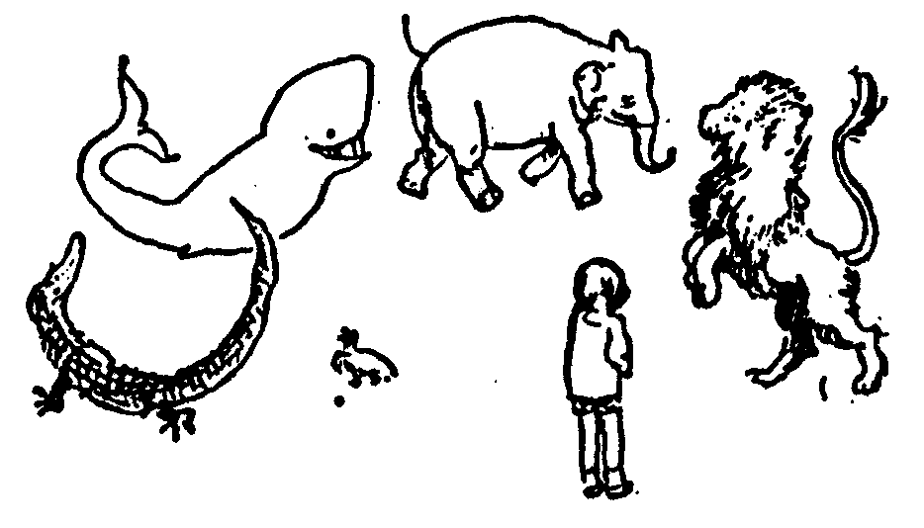
A Game Show Example
Instances: A set of objects and a relationship between them.
  Solutions for Instance: A subset of the objects. Or some other choice about each object.
Cost of Solution: The number of objects in solution or the sum of the costs of objects

Slide 13
The Brute Force Algorithm
Try every solution!
Exponential Time,
because exponentially many

Slide 14
The Greedy Choice
Commit to the object that looks the “best”
Must prove that this locally greedy choice
does not have negative global consequences.

Slide 15
Game Show Example with a Greedy Algorithm
Instances: A set of objects and a relationship between them.
  Goal: Find an optimal non-conflicting solution: Best Prizes.
Some subsets are not allowed
because some objects conflict
greedy algorithms do not try
to predict the future and do not back track
  Solutions for Instance: A subset of the objects. Or some other choice about each object.
Cost of Solution: The number of objects in solution or the sum of the costs of objects

Slide 16
1. Greedy Algorithms
Methodology:
贪婪/心算法通过一系列的局部选择来得到一个问题的解。即通过分步决策的方法求解问题，所作的每一个选择都是当前状态下“最优”的选择，每一步决策产生n-元组解（x₀,x₁,…,x_{n-1}）的一个分量。贪心法每一步上用作决策依据的选择准则被称为最优量度标准。
在选择解分量的过程中，添加新的解分量x_{k}后，形成的部分解（x₀,x₁,…,x_{k})不违反可行解约束条件。
每一次贪心选择都将所求问题简化为规模更小的子问题。
“只顾眼前，不管将来”

Slide 17
Preexample :Making Change
Instances: A set of objects and a relationship between them.
Amount = 92¢
25¢
25¢
25¢
25¢
25¢
25¢
25¢
25¢
25¢
25¢
10¢
10¢
10¢
10¢
10¢
10¢
10¢
10¢
10¢
10¢
5¢
5¢
5¢
5¢
5¢
5¢
5¢
5¢
5¢
5¢
1¢
1¢
1¢
1¢
1¢
1¢
1¢
1¢
1¢
1¢
  Solutions for Instance:
  A subset of the coins that total the amount.
Some subsets are not allowed
because some objects conflict
  Goal: Find an optimal non-conflicting solution.
Cost of Solution: The number of coins = 14 ？

Slide 18
The Brute Force Algorithm
Try every solution!
Exponential Time,
because exponentially many

Slide 19
The Greedy Choice
Commit to the object that looks the “best”
Must prove that this locally greedy choice
does not have negative global consequences.

Slide 20
Making Change Example with Greedy Strategy
Instances: A set of objects and a relationship between them.
25¢
90¢
50¢
Amount = 92¢
75¢
95¢
25¢
25¢
25¢
25¢
25¢
25¢
25¢
25¢
25¢
25¢
10¢
10¢
10¢
10¢
10¢
10¢
10¢
10¢
10¢
10¢
100¢
91¢
5¢
5¢
5¢
5¢
5¢
5¢
5¢
5¢
5¢
5¢
85¢
1¢
92¢
1¢
1¢
1¢
1¢
1¢
1¢
1¢
1¢
1¢
95¢
Greedy Choice:
Start by grabbing quarters until exceeds amount,
then dimes, then nickels, then pennies.
Does this lead to an optimal # of coins?
Cost of Solution: 7

Slide 21
Hard Making Change Example
Problem: Find the minimum # of 4, 3, and 1 cent coins
to make up 6 cents.
Greedy Choice: Start by grabbing a 4 coin.
Consequences:
4+1+1 = 6 mistake
3+3=6 better
Greedy Algorithm does not work!
课外思考题：假设可换的硬币的单位是c的幂，也就是c⁰, c¹,...,c^{k},其中整数c>1,k≥1。证明使用贪心算法总可以产生一个最优解。

Slide 22
Implement the Change Example
Problem: Choose the minimum number change.
Iterative Greedy Algorithm:
Loop: grabbing the best, then second best, ...
if it conflicts with committed objects
or fulfills no new requirements.
Reject this next best object
else
Commit to it.
Recursive Greedy Algorithm:
  Makes a greedy first choice and then uses recursion

Slide 23
Greedy Algorithms
Disadvantages:
They do not always work.
Short term choices may be disastrous on the long term.
Correctness is hard to prove
Advantages:
When they work, they work fast
Simple and easy to implement

Slide 24
When Does It Work?
Greedy Algorithms: Easy to understand and to code, but do they work?
For most optimization problems, all greedy algorithms tried do not work.
A few have greedy algorithms.
The proof that they work, however, is subtle.
As with all iterative algorithms, we use loop invariants.
Notes:
循环不变式（loop invariants）不只是一种计算机科学的思想，准确地说是一种数学思想。在数学上阐述了通过循环（迭代、递归）去计算一个累计的目标值的正确性，属于基础数学的范畴，而且在计算机上也应用广泛。
循环不变式主体是不变式，也就是一种描述规则的表达式。其过程分三个部分：初始，保持，终止。
（1）初始：保证在初始的时候不变式为真。
（2）保持：保证在每次循环开始和结束的时候不变式都为真。
（3）终止：如果程序可以在某种条件下终止，那么在终止的时候，就可以得到自己想要的正确结果。

Slide 25
Elements of Greedy Strategy
An greedy algorithm makes a sequence of choices, each of the choices that seems best at the moment is chosen
  NOT always produce an optimal solution (feasible)
Two ingredients that are exhibited by most problems that lend themselves to a greedy strategy
  Greedy-choice property
  Optimal substructure

Slide 26
Greedy-Choice Property
A globally optimal solution can be arrived at by making a locally optimal (greedy) choice
  Make whatever choice seems best at the moment and then solve the sub-problem arising after the choice is made
  The choice made by a greedy algorithm may depend on choices so far, but it cannot depend on any future choices or on the solutions to sub-problems
Of course, we must prove that a greedy choice at each step yields a globally optimal solution
Notes:
对于一个具体问题，要确定它是否具有贪心选择性质，必须证明每一步所作的贪心选择最终导致问题的整体最优解。

Slide 27
Optimal Substructures
A problem exhibits optimal substructure if an optimal solution to the problem contains it’s optimal solutions to sub-problems
The optimal substructure property of the problem is the key feature that the problem can be solved by greedy algorithm or dynamic programming algorithm
Notes:
当一个问题的最优解包含其子问题的最优解时，称此问题具有最优子结构性质。

Slide 28
Steps of Greedy Strategy
Determine the optimal substructure
Prove one of the optimal choices is the greedy choice yet safe
After greedy selection, only one sub problem should be left, and all other sub problems are empty
Develop a recursive algorithm or an iterative one that implements the greedy strategy
Notes:
确定待解问题的最优子结构
设计递归求解方式
证明在递归的任一阶段，最优选择之一总是贪心的（那么贪心选择是最适合的）
证明通过做贪心选择，所有的子问题都为空（除一个以外）
设计实现贪心策略的递归算法
将设计好的递归算法转换成迭代算法

Slide 29
The General method
Let a[ ] be an array of elements that may contribute to a solution. Let S be a solution,
Greedy (a[ ],n)
{
S = empty;
for each element (i) from a[ ], i = 1:n
{
x = Select (a,i);//遵循贪心策略选择一个分量x
if (Feasible(S,x)) //判断加入新分量x后部分解是否可行
S = Union(S,x); //形成新的部分解
}
return S; //返回生成的（最优）解
}
How about the complexity?

Slide 30
The General method (continued)
Select:
Selects an element from a[ ] and removes it. Selection is optimized to satisfy an objective function.
Feasible:
True if selected value can be included in the solution vector, False otherwise.
Union:
Combines value with solution and updates objective function.
Problems of the algorithm
It cannot be guaranteed that the final solution obtained is optimal;
It cannot be used to find the maximum or minimum solution;
Only the range of feasible solutions satisfying certain constraints can be found
=》Classic Examples

Slide 31
7.2.1 A Simple Example :Egyptian Fraction
Problem :In early Egypt, people only used unit fractions (fraction of the form ) to represent the fractional numbers instead of decimals, and fractions other than the unit fraction (like ) as we use today. For example, 7/8=1/2+1/3+1/24。
How to get it ？(Divide 3 cakes equally among 4 people)
Ideas: A fractions less than 1 can be represented by different Egyptain fractions. One object is to use the least Egyptian fractions , then we can use greedy strategy to select the maximum Egyptian fraction each iteration。
  Example: 7/8
  First choice: 7/8>1/2, then ½ is selected ；
  Second choice: 7/8-1/2=3/8>1/3，then 1/3 is selected；
  Third choice 3/8-1/3=1/24,then 1/24is selected。
  7/8=1/2+1/3+1/24
Notes:
A common example always given for the use of Egyptian fraction is something dividing
equally among few people. For example, dividing 3 pizzas among 4 people or dividing 5
bars of gold among 8 people, etc.
Fibonacci's Greedy Algorithm
Shortest Egyptian Fractions 4/17?
Fixed Length Egyptian Fractions

Slide 32
A Simple Example :Egyptian Fraction
Idea
Let the fraction is A/B(A<B)， The integral part of B divided by A is C, and the remainder is D, then ：
B＝A*C+D (D<A)
that is : B/A=C+D/A<C+1
then A/B>1/(C+1)
That is to say,1/(C+1) is the maximum Egyptian fractions contained in A/B。
Let E＝C+1，we can find A/B-1/E=((A*E)-B)/(B*E)
这个分数可能存在公因子，可将分子和分母同时除以最大公约数。

Slide 33
A Simple Example :Egyptian Fraction
Algorithm: Egyptian fractions
Input：a fraction with A and B and A<B
Output：the summary form of least Egyptian fractions
1. E＝B/A+1; //E＝C+1
2. Output 1/E;
3. A=A*E-B; B=B*E;
4. Find the maximum common divisor R of A and B. If R is not 1, divide A and B by R at the same time
5. If A equals 1, output 1/B, and the algorithm ends; Otherwise, go to step 1

Slide 34
A Simple Example :Egyptian Fraction
void EgyptFraction(int A, int B) {
int E,R;
cout<<A<<“/”<<B<<“=”;
do{
E=B/A+1;
cout<<“1/”<<E<<“+”;
A=A*E-B; B=B*E;
R=CommFractor(B,A); //CommFractor为求最大公约数函数
if( R>1 ){
A=A/R; B=B/R;
}
}while( A>1);
cout<<“1/”<<B<<endl;
return;
}
Any other ideas?
https://www.ics.uci.edu/~eppstein/numth/egypt/intro.html
Notes:
O(B)(按最坏情况看，必须A/B分解为A个1/B)

Slide 35

7.2.2 Activity-selection Problem
Suppose A set of activities S={a₁, a₂,…, a_{n}}
  They use resources, such as lecture hall, one lecture at a time
  Each a_{i}, has a start time s_{i}, and finish time f_{i}, with 0≤ s_{i}< f_{i}<∝.
  a_{i} and a_{j} are compatible if [s_{i}, f_{i}) and [s_{j}, f_{j}) do not overlap
Goal: select maximum-size subset of mutually compatible activities.

Slide 36
7.2.2 Activity-selection Problem
Input: Set S of n activities, a₁, a₂, …, a_{n}.
  s_{i} = start time of activity i.
  f_{i} = finish time of activity i.
Output: Subset A of maximum number of compatible activities.
  Two activities are compatible, if their intervals don’t overlap.
Example:
Activities in each line
are compatible.
2
5
3
6
1
4
7

Slide 37
Activity Selection Problem Example
Activities:
playground
Archery
Football
Fencing
Driving
Baseball
Golf
9
10
11
12
13
14
15
16
17

Slide 38
How to solve it
Dynamic programming?
Memorize?
Yes, but…
Activity selection problem also exhibits the greedy choice property:

Slide 39
应用实例
活动安排问题—直觉贪心策略
策略1：尽早占用。
把活动按照开始时间从小到大排序，使得s₁ ≤ s₂ ≤… ≤s_{n}，然后从前向后挑选，只要与前面选择的活动相容，便将这项活动选入最大相容集合A。
策略2：时间占用少的活动先安排。
计算每个活动占用时间fi-si，按照占用时间从小到大对活动排序，使得f1-s1 ≤ f2-s2 ≤… ≤fn-sn，然后从前向后挑选，只要与前面活动相容，便将这项活动选入最大相容集合A。
策略3：早完成的活动先安排。
把活动按照截止时间从小到大排序，使得f1 ≤ f2 ≤… ≤fn ，然后从前向后挑选，只要与前面选择的活动相容，便将这项活动选入最大相容集合A。

Slide 40
Activity Selection Problem
Archery
Football
Fencing
Driving
Baseball
Golf
9
10
11
12
13
14
15
16
17
How to make an arrangement to have the more activities?
S1. First starting activity first
Archery, Driving
S2. Shortest activity first
Baseball, Driving
S3. First finishing activity first
Baseball, Golf, Fencing
40

Slide 41
Activity Selection Problem
Problem Definition
  n activities require exclusive use of a common resource
    Set of activities S = {a ₁, a ₂, … , a _{n} }
    a _{i} needs resource during period [s_{i} , f _{i} )
      s_{i} : start time; f _{i} : finish time
  Goal
    Select the maximum number of non-overlapping (mutually compatible) activities.
√
s₁
f₁
s₂
f₂
s₁
s₂
f₁
f₂

Slide 42

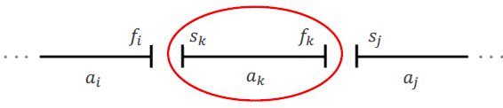
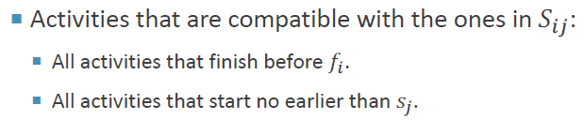
Representing the Problem
Let S_{ij} = subset of activities in S that start after a_{i} finishes and finish before a_{j} starts.
Subproblems: Selecting maximum number of mutually compatible activities from S_{ij}.

Slide 43

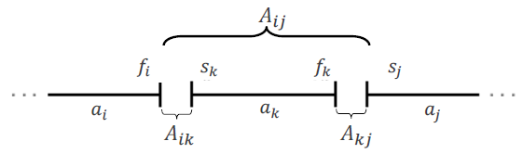
Representing the Problem
𝑆_{1n} does not cover the original problem because 𝑎₁ and 𝑎_{n} are excluded.
We can add two fictitious activities:
Let c[i, j] = |A_{ij}| size of maximum-size subset of mutually compatible activities in S_{ij}.
Dynamic Programming
Recursive
Solution:

Slide 44
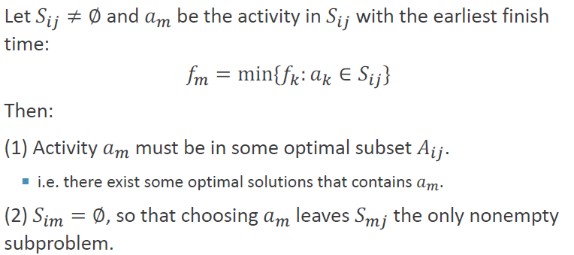
Simple Idea with Greedy Choice
Theorem

Slide 45
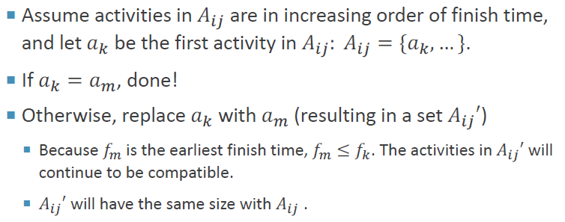
Proof of the Theorem
Proof of (1) Activity 𝑎_{m} must be in some optimal subset 𝐴_{ij}:
Proof of (2) is obviously.

Slide 46
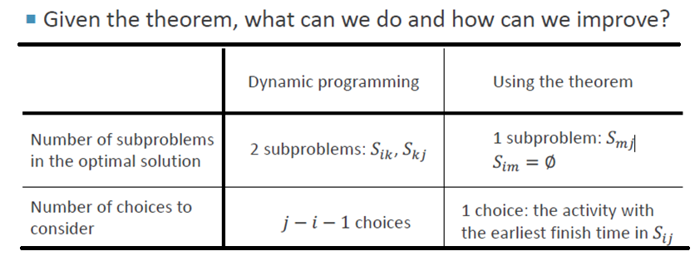
How to Simplify …
Making the greedy choice (the activity with the earliest finish time in 𝑆_{ij})
  Reduce the number of subproblems and choices.
  Solve each subproblem in a top-down fashion.

Slide 47
Greedy Approach
To select a maximum size subset of mutually compatible activities from set 𝑆_{ij}:
  Choose 𝑎_{m} ∈ 𝑆_{ij} with earliest finish time (greedy choice).
  Add 𝑎_{m} to the set of activities used in the optimal solution.
  Solve the same problem for the set 𝑆_{mj}.
From the theorem, it is proved that by choosing 𝑎_{m} we are guaranteed to have used an activity included in an optimal solution
We do not need to solve the subproblem 𝑆_{mj} before making the choice!

Slide 48
Greedy-Choice Property
Show there is an optimal solution that begins with a greedy choice (with activity 1, which as the earliest finish time)
Suppose A ⊆ S in an optimal solution
  Order the activities in A by finish time. The first activity in A is k
    If k = 1, the schedule A begins with a greedy choice
    If k ≠ 1, show that there is an optimal solution B to S that begins with the greedy choice, activity 1
    Let B = A – {k} ∪ {1}
    f₁ ≤ f_{k} → activities in B are disjoint (compatible)
    B has the same number of activities as A
    Thus, B is optimal

Slide 49
Optimal Substructures
  Once the greedy choice of activity 1 is made, the problem reduces to finding an optimal solution for the activity-selection problem over those activities in S that are compatible with activity 1
    Optimal Substructure
    If A is optimal to S, then A’ = A – {1} is optimal to S’={i ∈S: s_{i} ≥ f₁}
    Why?
      If we could find a solution B’ to S’ with more activities than A’, adding activity 1 to B’ would yield a solution B to S with more activities than A ➔ contradicting the optimality of A
  After each greedy choice is made, we are left with an optimization problem of the same form as the original problem
    By induction on the number of choices made, making the greedy choice at every step produces an optimal solution

Slide 50
Recall
1. Elements of Greedy Algorithms
2. Steps of Greedy Algorithms
3. General Methods of Greedy Algorithms
4. Egyptian Fractions
5. Activity Selection Problem
  Problem Representation
  Recursive Relation
  Simplication with Greedy
  Proof of correctness

Slide 51
Example: A Recursive Greedy Algorithm
i | 0 | 1 | 2 | 3 | 4 | 5 | 6 | 7 | 8 | 9 | 10 | 11
s_{i} | - | 1 | 3 | 0 | 5 | 3 | 5 | 6 | 8 | 8 | 2 | 12
f_{i} | 0 | 4 | 5 | 6 | 7 | 8 | 9 | 10 | 11 | 12 | 13 | 14
For the Greedy Algorithm, the set S of activities is sorted in increasing order of finish time

Slide 52
活动安排计算过程
2
1
3
i | s_{i} | f_{i}
1 | 1 | 4
2 | 3 | 5
3 | 0 | 6
4 | 5 | 7
5 | 3 | 8
6 | 5 | 9
7 | 6 | 10
8 | 8 | 11
9 | 8 | 12
10 | 2 | 13
11 | 12 | 14
1
√
4
1
5
1
4
√
6
1
4
7
1
4
8
1
4
9
√
1
4
8
10
1
4
8
11
√
1
4
8
1
4
8
11
0
1
2
3
4
5
6
7
8
9
10
11
12
13
14

Slide 53
活动安排问题
活动安排问题的贪心算法GreedySelector :
template<class Type>
void GreedySelector(int n, Type s[], Type f[], bool A[])
{
A[1]=true;
int j=1;
for (int i=2;i<=n;i++) {
if (s[i]>=f[j]) { A[i]=true; j=i; }
else A[i]=false;
}
}
各活动的起始时间和结束时间存储于数组s和f中且按结束时间的非减序排列
时间复杂度？
O(nlgn)+O(n)

Slide 54
An Iterative/Recursive Greedy Algorithm
Activities are ordered in increasing order of finish time.
IterativeActivitySelector (s, f)
1 n ← length[s]
2 A ← {a₁}
3 i ← 1
4 for m ← 2 to n
5 do if s_{m} ≥ f_{i}
6 then A ← A ∪ {a_{m}}
7 i ← m
8 return A
RecursiveTaskSelect(𝑠, 𝑓, 𝑖, 𝑗)
1 𝑚 ← 𝑖 + 1
2 while 𝑚 < 𝑗 and 𝑠_{m} < 𝑓_{i} do
3 𝑚 ← 𝑚 + 1
4 if 𝑚 < 𝑗 then return {𝑎_{m}} ∪
RecursiveTaskSelect(𝑠, 𝑓, 𝑚, 𝑗)
5 else return ∅
时间复杂度？
O(nlgn)+O(n)
How about multi-resouces?
How many resouces needed to allocate all?

Slide 55
练习：最小延迟调度
课外思考题：
任务集合S，∀i∈S，d_{i} 为截止时间，t_{i} 为加工时间，
其中 d_{i} , t_{i}为正整数.
一个调度 f : S→N，f(i)为任务 i 的开始时间. 试设计贪心算法求最大延迟达到最小的调度，即求 f 使得
并证明你的算法的正确性。

Slide 56
实例
S={1, 2, 3, 4, 5}, d=<10, 12, 15, 11, 20>, t=<5, 8, 4, 10, 3>
调度1： f₁(1)=0, f₁(2)=5, f₁(3)=13, f₁(4)=17, f₁(5)=27
各任务延迟：0, 1, 2, 16, 10; 最大延迟：16
5 13 17 27 30
1 2 3 4 5
调度2： f₂(1)=0, f₂(2)=15, f₂(3)=23, f₂(4)=5, f₂(5)=27
各任务延迟：0, 11, 12, 4, 10; 最大延迟：12
5 15 23 27 30
1 4 2 3 5

Slide 57
贪心策略选择
贪心策略1：按照 t_{i} 从小到大安排任务
贪心策略2：按照 d_{i} − t_{i} 从小到大安排任务
贪心策略3：按照 d_{i} 从小到大安排任务
策略1 对某些实例得不到最优解.
反例：t₁=1, d₁=100, t₂=10, d₂=10
策略2 对某些实例得不到最优解.
反例：t₁=1, d₁=2, t₂=10, d₂=10

Slide 58
算法设计
算法思想：
按照截止时间 d_{i} 从小到大选择任务
安排时不留空闲时间
算法
1. Sort(S) 使得 d₁≤d₂ ≤ …≤ d_{n}
2. f(1)←0，i←2
3. while i≤n do
4. f(i)←f(i−1)+t_{i−1}
5. i←i+1

Slide 59
Dynamic Programming vs. Greedy Algorithms
Dynamic programming
  Make a choice at each step.
  The choice depends on solutions to subproblems.
  Bottom up solution, from smaller to larger subproblems.
Greedy algorithm
  Make the greedy choice.
  Solve the subproblem arising after the choice is made.
  The choice we make may depend on previous choices, but not on solutions to subproblems.
  Top down solution, problems decrease in size.
Common: Optimal substructure

Slide 60
7.2.3 Knapsack Problem

Slide 61
7.2.3 The Knapsack Problem
The famous knapsack problem:
  A thief breaks into a museum. Fabulous paintings, sculptures, and jewels are everywhere. The thief has a good eye for the value of these objects, and knows that each will fetch hundreds or thousands of dollars on the clandestine art collector’s market. But, the thief has only brought a single knapsack to the scene of the robbery, and can take away only what he can carry.
  What items should the thief take to maximize the haul?

Slide 62
The Fractional Knapsack Problem
Given: A set S of n items, with each item i having
  b_{i} - a positive benefit
  w_{i} - a positive weight
Goal: Choose items with maximum total benefit but with weight at most W.
If we are allowed to take fractional amounts, then this is the fractional knapsack problem.
  In this case, we let x_{i} denote the amount we take of item i
  Objective: maximize
  Constraint:

Slide 63
0-1 Knapsack problem
Given a knapsack with maximum capacity W, and a set S consisting of n items
Each item i has some weight w_{i} and benefit value b_{i} (all w_{i} , b_{i} and W are integer 0/1 values)
Problem: How to pack the knapsack to achieve maximum total value of packed items?

Slide 64
Solving The Knapsack Problem
Both variations exhibit optimal substructure
Here discuss Fractional Knapsack Problem
The optimal solution to the fractional knapsack problem can be found with a greedy algorithm
How to make a possible greedy choice:
  take in order of values
  take in order of weight
  take in order of values/weight

Slide 65
7.2.3 The Fractional Knapsack example
Considering the following fractional knapsack n=3,M=20,(p₁,p₂,p₃)=(25,24,15),
(w₁,w₂,w₃)=(18,15,10)
List four feasible solutions here：
 | (x₁,x₂,x₃) | ∑w_{i} x_{i} | ∑p_{i}x_{i}
Strategy 0 | (1/2,1/3,1/4) | 16.5 | 24.25
Strategy 1 | (1,2/15,0) | 20 | 28.2
Strategy 2 | (0,2/3,1) | 20 | 31
Strategy 3 | (0,1,1/2) | 20 | 31.5
It seems ok! But how to prove?

Slide 66
Greedy Algorithm
Greedy strategy 3: greatest value-per-weight ratio first
Algorithm
  Sort n items according to the decending order of value-per-weight ratio αi = vi/wi.
  Iteratively picks the item with the greatest value-per-weight ratio（x_{i} = 1）
  if, at some step, the knapsack cannot fit the entire last item with current greatest value-per-weight ratio items, we will take a fraction of it to fill the knapsack.（x_{i} = the current weight limit k/wi）

Slide 67
Correctness Proof (1/3)
Lemma. ∀ input size n, the algorithm yields the optimal solution.
Proof idea. Mathematical induction on input size.
Induction basis. When n = 1, the greedy algorithm is obviously the
optimal solution.
Induction step. Suppose the algorithm is optimal for n = k, then it
is also optimal for n = k + 1. How?
Let x₁ be the algorithm’s output for the ﬁrst item,
I = (x₂ , . . . , x_{k+1}) be the output on instance (w₂ , . . . , w_{k+1}),
(v₂ , . . . , v_{k+1}), and W- x₁w₁
′
′
According to the induction premise, I is the optimal solution
′
of the above sub-instance of size n = k. Let I = x₁ ∪ I .
Then, we want to claim I is the optimal solution for n = k + 1.

Slide 68
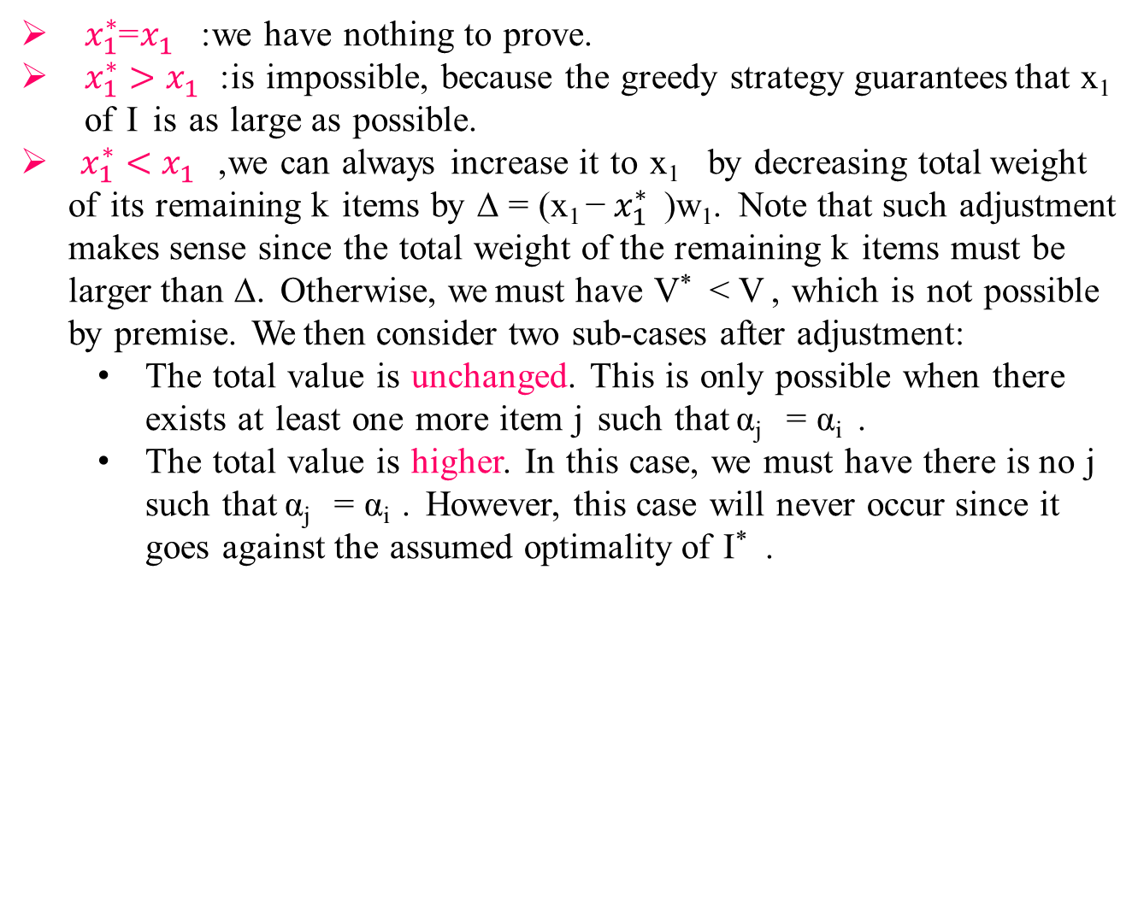
Correctness Proof (2/3)
Proof by contradiction. If not, suppose there exists a more optimal
solution I* with maximal value V* .
Prove the ﬁrst element $x_{1}^{∗}$ of I* must be equal to x₁ of I.
$x_{1}^{∗}$=$x_{1}^{}$: we have nothing to prove.
$x_{1}^{∗}>x_{1}^{}$: is impossible, because the greedy strategy guarantees that x₁ of I is as large as possible.
$x_{1}^{∗}<x_{1}^{}$, we can always increase it to x₁ by decreasing total weight of its remaining k items by ∆ = (x₁ − $x_{1}^{∗}$ )w₁. Note that such adjustment makes sense since the total weight of the remaining k items must be larger than ∆. Otherwise, we must have V*< V , which is not possible by premise. We then consider two sub-cases after adjustment:
The total value is unchanged. This is only possible when there exists at least one more item j such that α_{j} = α_{i} .
The total value is higher. In this case, we must have there is no j such that α_{j} = α_{i} . However, this case will never occur since it goes against the assumed optimality of I* .

Slide 69

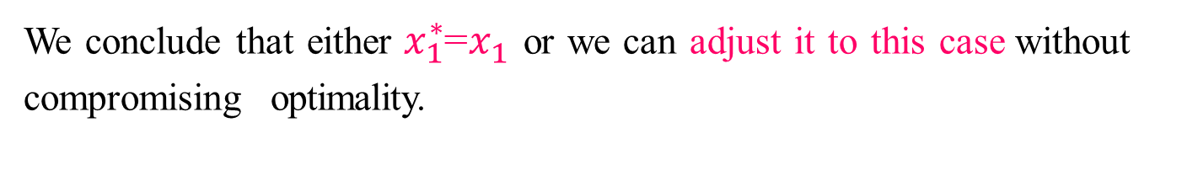
Correctness Proof (3/3)
We conclude that either $x_{1}^{∗}$=$x_{1}^{}$or we can adjust it to this case without compromising optimality.
I*− {x₁ } forms a solution for W− $x_{1}^{∗}$ w₁= W− x₁w₁with
items (2, . . . , n + 1) with total value V*− α₁x₁ > V − α₁x₁; which contradicts the optimality of I
This proves I is the optimal solution for input size n = k + 1.

Slide 70
The Fractional Knapsack Algorithm
Greedy choice: Keep taking item with highest value (benefit to weight ratio)
  Since
  Run time: O(n log n).
  Why?
Algorithm fractionalKnapsack(S, W)
Input: set S of items w/ benefit b_{i} and weight w_{i}; max. weight W Output: amount x_{i} of each item i to maximize benefit w/ weight at most W
for each item i in S
  x_{i} ← 0
  v_{i} ← b_{i} / w_{i} {value}
  w ← 0 {total weight}
  while w < W
  remove item i w/ highest v_{i}
  x_{i} ← min{w_{i} , W - w}
  w ← w + min{w_{i} , W - w}

Slide 71
The Fractional Knapsack Algorithm
void Knapsack(int n,float M,float v[],float w[],float x[])
{
Sort(n,v,w); //Sort by V_{i}/W_{i}
  int i;
  for (i=1;i<=n;i++) x[i]=0;
  float c=M;
  for (i=1;i<=n;i++)
  { if (w[i]>c) break;
    x[i]=1;
    c-=w[i];
  }
  if (i<=n) x[i]=c/w[i]; //允许放入一个物品的一部分
}
  How about the Run time?
  O(n log n).
How about 0-1背包问题?

Slide 72
About The 0-1 Knapsack Problem
The optimal solution to the 0-1 problem cannot be found with the same greedy strategy
  Greedy strategy: take in order of dollars/pound
  Example: 3 items weighing 10, 20, and 30 pounds, knapsack can hold 50 pounds
    Suppose item 2 is worth $100. Assign values to the other items so that the greedy strategy will fail
60,100,90
Reason？
0-1背包问题贪心选择之所以不能得到最优解：因为无法保证最终能将背包装满，部分闲置的背包空间使总价值降低了。
Notes:
0-1背包问题贪心选择之所以不能得到最优解：因为无法保证最终能将背包装满，部分闲置的背包空间使总价值降低了。

Slide 73
课堂练习（分组）
1、10个活动争用一个活动室，占用时间如下图所示，求一个相容的活动子集，且安排活动数目最多。
i | a | b | c | d | e | f | g | h | i | j
开始时间 | 3 | 2 | 1 | 5 | 4 | 3 | 2 | 9 | 7 | 6
结束时间 | 6 | 5 | 4 | 7 | 9 | 7 | 3 | 11 | 10 | 9
2、已知有3个物品，物品可拆分，(w₁,w₂,w₃)=(12,10,6), (p₁,p₂,p₃)=(16,15,12), 背包的容积M=15，利用贪婪算法求解背包价值最高的解，要求对求解过程进行简单的算法描述。

Slide 74
课堂练习（分组）
1、10个活动争用一个活动室，占用时间如下图所示，求一个相容的活动子集，且安排活动数目最多。
i | a | b | c | d | e | f | g | h | i | j
s | 3 | 2 | 1 | 5 | 4 | 3 | 2 | 9 | 7 | 6
f | 6 | 5 | 4 | 7 | 9 | 7 | 3 | 11 | 10 | 9
1、排序
2、选择比较
3、整理解
i | g | c | b | a | d | f | e | j | i | h
s | 2 | 1 | 2 | 3 | 5 | 3 | 4 | 6 | 7 | 9
f | 3 | 4 | 5 | 6 | 7 | 7 | 9 | 9 | 10 | 11
{ g, a, j, h }

Slide 75
课堂练习（分组）
2.已知有3个物品，物品可分割，(w₁,w₂,w₃)=(12,10,6),
(p₁,p₂,p₃)=(16,15,12), 背包的容积M=15，利用贪心算法求解背包价值最高的解，要求对求解过程进行简单的算法描述。
将各物体按单位价值由高到低排序，物品3（12/6）>物品2（15/10）>物品1（16/12）.
取价值最高者物品3放入背包. 计算背包剩余空间15-6=9.
在剩余物体中取价值最高者放入背包，取物品2的9/10放入背包，此时背包剩余容量为0.
背包内最高价值：12+9/10*15=25.5
即放入物品2的9/10,放入物品3的全部，背包价值达到最高，为25.5.

Slide 76
扩展：最优装载（自学）
有一批集装箱要装上一艘载重量为C的轮船。其中集装箱i的重量为Wi。最优装载问题要求确定在装载体积不受限制的情况下，将尽可能多的集装箱装上轮船。
问题可形式化描述为
其中变量x_{i}=0表示不装入集装箱i，x_{i}=1表示装入集装箱i。
采用重量最轻者先装的贪心选择策略

Slide 77
最优装载
[算法思路] 将装船过程划为多步选择，每步装一个货箱，每次从剩下的货箱中选择重量最轻的货箱.如此下去直到所有货箱均装上船或船上不能再容纳其他任何一个货箱。
[例]
设N=8,[w1，…w8]=[100, 200, 50, 90, 150, 50, 20, 80]，C=400。
所考察货箱的次序为 t[1..8]={7, 3, 6, 8, 4, 1, 5, 2}。货箱7, 3, 6, 8, 4, 1的总重量为390个单位且已被装载, 剩下的装载能力为10 ,小于任意货箱.所以得到解[x1,...x8]=[ 1, 0, 1, 1, 0, 1, 1, 1]

Slide 78
最优装载算法描述
最优装载问题可用贪心算法求解。采用重量最轻者先装的贪心选择策略，可产生最优装载问题的最优解。
void Loading(int x[], Type w[], Type c, int n)
  { int *t = new int [n+1];
    Sort(w, t, n); //按货箱重量排序O(nlogn)
    for (int i = 1; i <= n; i++) x[i] = 0; //O(n)
    for (int i = 1; i <= n && w[t[i]] <= c; i++)
    {x[t[i]] = 1; c -= w[t[i]];} //调整剩余空间
  }
课外思考题：证明其正确性

Slide 79
课堂练习题
设N=8,[w1，…w8]=[100, 200, 50, 90, 150, 50, 20, 80]，C=400。
编程求t[1..8].

Slide 80
7.2.4 Optimal Merge Patterns
Definitions
Binary Merge Tree:
A binary tree with external nodes representing entities and internal nodes representing merges of these entities.
Optimal Binary Merge Tree:
The sum of paths from root to external nodes is optimal (e.g. minimum). Assuming that the node (i) contributes to the cost by p_{i} and the path from root to such node has length L_{i}, then optimality requires a pattern that minimizes

Slide 81
7.2.4 Optimal Binary Merge Tree
If the items {A,B,C} contribute to the merge cost by P_{A} , P_{B} , P_{C}, respectively, then the following 3 different patterns will cost:
P₁= 2(P_{A}+P_{B})+P_{C} P₂ = P_{A}+2(P_{B}+P_{C}) P₃ = 2P_{A}+P_{B}+2P_{C}
Which of these merge patterns is optimal?

Slide 82
Optimal Merging of Lists
Lists {A,B,C} have lengths 30,25,10, respectively. The cost of merging two lists of lengths n,m is n+m. The following 3 different merge patterns will cost:
P₁= 2(30+25)+10 = 120 P₂ = 30+2(25+10) = 100 P₃ = 25+2(30+10) = 105
P₂ is optimal so that the merge order is {{B,C},A}.
So, Any Idea？

Slide 83
The Greedy Method
Insert lists and their lengths in a minimum heap of lengths.
Repeat
  Remove the two lowest length lists (p_{i} ,p_{j}) from heap.
  Merge lists with lengths (p_{i},p_{j}) to form a new list with length p_{ij} = p_{i}+ p_{j}
  Insert p_{ij} and its into the heap
until all symbols are merged into one final list
Notice that both Lists (B : 25 elements) and (C : 10 elements) have been merged (moved) twice
List (A : 30 elements) has been merged (moved) only once.
Hence the total number of element moves is 100.
This is optimal among the other merge patterns.
C | 10
B | 25 | A | 30
A | 30 | BC | 35 | BCA | 65

Slide 84
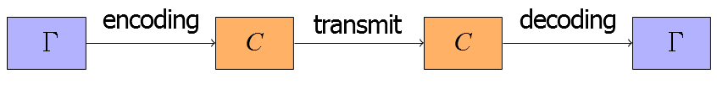
7.2.4 Application –Huffman Coding
Huffman coding is a very effective coding method widely used in data file compression. The compression ratio is usually between 20% and 90%
Huffman coding algorithm uses the frequency table of characters in the file to establish an optimal representation of characters with 0,1 strings
Coding objective: to encode shorter characters with higher frequency and longer characters with lower frequency, which can greatly reduce the total code length.

Slide 85
Discussion
Some Concepts:
  WPL
  Entropy: The absolute minimum < L > in a message (Shannon)
  H = Σ_{1≤ i ≤ n} Pi log (1/ Pi) = - Σ_{1≤ i ≤ n} Pi log Pi
  Coding Efficiency: η = H / < L > 0 ≤ η ≤ 1
  Coding Redundancy: R = 1 - η 0 ≤ R ≤ 1
Fixed Length Coding
  Fixed length coding is optimal (perfect) only when all symbol probabilities are equal.
Variable Length Coding
  Huffman Coding/ prefix coding
Huffman tree algorithm
Example

Slide 86
Coding Efficiency & Redundancy
L_{i} =Length of path from root to symbol (i) = no. of bits representing that symbol.
P_{i} = probability of occurrence of symbol (i) in message.
n = size of alphabet.
< L > = Average Symbol Length/weighted path length
= Σ_{1≤ i ≤ n} P_{i} L_{i} bits/symbol (bps)
For fixed length coding, L_{i} = L = constant, < L > = L (bps)
Is this optimal (minimum) ? Not necessarily.
The absolute minimum < L > in a message is called the Entropy:
H = Σ_{1≤ i ≤ n} P_{i} log (1/ P_{i}) = - Σ_{1≤ i ≤ n} P_{i} log P_{i}
Coding Efficiency: η = H / < L > 0 ≤ η ≤ 1
Coding Redundancy: R = 1 - η 0 ≤ R ≤ 1

Slide 87
Example: Fixed Length Coding
4- Symbol Alphabet (a,b,c,d). All symbols have the same length L = 2 bits
Message : abbcaada
< L > = 2 (bps)
Coding Efficiency η = H / < L > = 1.75 / 2 = 0.875,
Coding Redundancy R = 1 – 0.875 = 0.125
This is not optimal
Symbol (i) | p_{i} | -log p_{i} | -p_{i} log p_{i} | code | L_{i}
a | 0.5 | 1 | 0.5 | 00 | 2
b | 0.25 | 2 | 0.5 | 01 | 2
c | 0.125 | 3 | 0.375 | 10 | 2
d | 0.125 | 3 | 0.375 | 11 | 2
H = 1.75

Slide 88
Result
Fixed length coding is optimal (perfect) only when all symbol probabilities are equal.
To prove this:
With n = 2^{m} symbols, L = m bits and <L> = m (bps).
If all probabilities are equal,

Slide 89
Variable Length Coding
(Huffman Coding)
To achieve optimality, we use optimal binary merge trees to code symbols of unequal probabilities.
Huffman Coding:
More frequent symbols occur nearer to the root ( shorter code lengths), less frequent symbols occur at deeper levels (longer code lengths).
Symbols exist at leaves, i.e., no symbol code is the prefix of another symbol code.
This is why the method is also called “prefix coding”

Slide 90
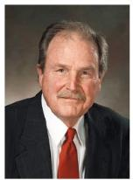
The Greedy Method
[David A. Huffman, 1952] A Minimum-Redundancy Coding Method
Store each symbol in a parentless node of a binary tree.
Insert symbols and their probabilities in a minimum heap
of probabilities.
Repeat
  Remove lowest two probabilities (p_{i} ,p_{j}) from heap.
  Merge symbols with (p_{i},p_{j}) to form a new symbol (a_{i}a_{j}) with
  probability p_{ij} = p_{i}+ p_{j}
  Store symbol (a_{i}a_{j}) in a parentless node with two children a_{i} and a_{j}
  Insert p_{ij} and its symbols into the heap
until all symbols are merged into one final alphabet (root)
Trace path from root to each leaf (symbol) to form the bit string for that symbol. Concatenate “0” for a left branch, and “1” for a right branch.
Notes:
1952年

Slide 91
Correctness Proof of Huffman Encoding
Theorem. Huffman algorithm yields optimal prefix-free encoding binary tree for all |Γ| ≥ 2.
Proof. Mathematic induction
Induction basis. For |Γ| = 2, Huffman algorithm yields optimal prefix-free encoding.
Induction step. Assume Huffman algorithm encoding yields optimal prefix-free encoding for size k, then it also yields optimal prefix-free encoding for size k + 1.

Slide 92
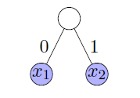
Induction Basis
k = 2, Γ = {x₁, x₂}
Any codeword at least require at least one bit. Huffman algorithm yields code word 0 and 1, which is optimal prefix-free encoding.
Notes:
Gamma

Slide 93
Induction Step (1/3)
Assume Huffman algorithm yields optimal prefix-free encoding for input size k. Now, consider input size k + 1, a.k.a. |Γ| = k + 1
Γ = {x₁, x₂, . . . , x_{k+1}}
Let Γ′ = (Γ − {x₁, x₂}) ∪ {z}, f_{z} = f_{x1} + f_{x2}
Induction premise ⇒ Huffman algorithm generates an optimal prefix-free encoding tree T ′ for Γ′, where frequencies are f_{z} and f_{xi} (i = 3, 4, . . . , k + 1).
Notes:
Gamma

Slide 94
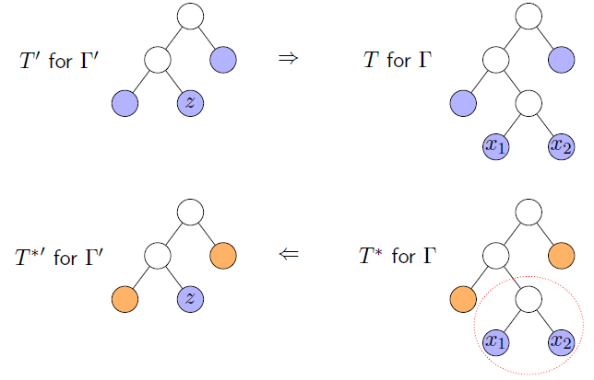
Induction Step (2/3)
Claim. Append (x₁, x₂) as z’s children to T ′, obtaining T (greedy algorithm’s output), which is an optimal prefix-free encoding tree for Γ = (Γ′ − {z}) ∪ {x₁, x₂}.
Difference of WPL ?

Slide 95
Induction Step (3/3)
Proof. If not, then there exists an optimal prefix-encoding free tree
T ∗, L(T ∗) < L(T ).
Note that :x₁ and x₂ must be the sibling leaves in the deepest level.
Idea. Reduce to the optimality of T ′ for Γ′
Remove x₁ and x₂ from T ∗, obtaining a new encoding tree T ∗′
L(T ∗′) =L(T ∗) − (f_{x1} + f_{x2} )
<L(T ) − (f_{x1} + f_{x2} )
=L(T ′)
This contradicts to the premise that T ′ is an optimal prefix-free encoding tree for Γ′.

Slide 96
Analysis
The cost of insertion in a minimum heap is O(n logn)
The repeat loop is done (n-1) times.
In each iteration, the worst case removal of the least two elements is 2 logn and the insertion of the merged element is logn
Hence, the complexity of the Huffman algorithm is
O(n logn)
Important Result:
Perfect coding (η = 100 %) can be achieved only for
probability values of the form 2^{- m} (1/2, ¼, 1/8,…etc )

Slide 97
Time Complexity
Q. What is the time complexity?
A. T(n) = T(n-1) + O(n) so O(n²)
Q. How to implement finding lowest-frequency letters efficiently?
A. Use priority queue for S: T(n) = T(n-1) + O(log n) so O(n log n)

Slide 98
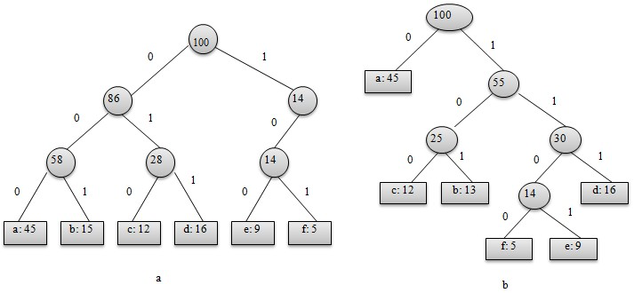
定长码
变长码
表示最优前缀码的二叉树是一棵严格二叉树，即树中任意非叶节点都有2个儿子。左图表示定长编码方案不是最优的。一般情况下，若C是编码字符集，表示其最优前缀码的二叉树中恰有|C|个叶子。每个叶子对应于字符集中的一个字符，该二叉树有|C|-1个内部节点。

Slide 99
(2) 最优子结构性质
引理：设T为表示字母表C上一种最优前缀代码的完全二叉树。对C中每个字符定义有频度f[c]。考虑T中任意两个为兄弟叶节点的字符x和y，并设z为它们的父节点。那么，若认为z是一个频度为f[z]=f[x]+f[y]的字符的话，树T‘=T-｛x,y｝就表示了字母表C’=C-{x,y}∪{z}上的一种最优前缀编码。
去掉x,y后计算各部分代价：
f[x]d_{T}(x) + f[y]d_{T}(y) = (f[x]+f[y])(d_{T’}(z)+1) = f[z]d_{T’}(z) + (f[x]+f[y])
所以根据此式：B(T)=B(T’) + f[x] + f[y]
如果T’代表C’上一种非最优前缀代码，则存在叶节点为C’中的字符的树T’’，将x和y插入T’’中使它们成为z的子结点，可以得到C的一种前缀代码，使得B(T'') + f[x] + f[y] < B(T)，和T的最优性矛盾。

Slide 100
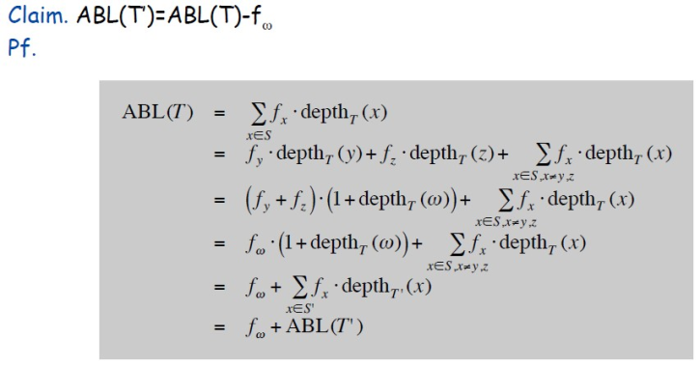
Huffman Encoding: Greedy Analysis
Claim. Huffman code for S achieves the minimum ABL of any prefix code.
Pf. by induction, based on optimality of T’ (y and z removed, ω added)
Notes:
Average binary length

Slide 101
Huffman Encoding: Greedy Analysis
Claim. Huffman code for S achieves the minimum ABL of any prefix code.
Pf. (by induction)
Base: For n=2 there is no shorter code than root and two leaves.
Hypothesis: Suppose Huffman tree T’ for S’ of size n-1 with ω instead of y and z is optimal. (IH)
Step: (by contradiction)
Idea of proof:
– Suppose other tree Z of size n is better.
– Delete lowest frequency items y and z from Z creating Z’
– Z’ cannot be better than T’ by IH.

Slide 102
Huffman Encoding: Greedy Analysis
Claim. Huffman code for S achieves the minimum ABL of any prefix
code.
Pf. (by induction)
Base: For n=2 there is no shorter code than root and two leaves.
Hypothesis: Suppose Huffman tree T’ for S’ with ω instead of y and z is optimal. (IH)
Step: (by contradiction)
Suppose Huffman tree T for S is not optimal.
So there is some tree Z such that ABL(Z) < ABL(T).
Then there is also a tree Z for which leaves y and z exist that are
siblings and have the lowest frequency (see observation).
Let Z’ be Z with y and z deleted, and their former parent labeled ω.
Similar T’ is derived from S’ in our algorithm.
We know that ABL(Z’)=ABL(Z)-fω, as well as ABL(T’)=ABL(T)-fω.
But also ABL(Z) < ABL(T), so ABL(Z’) < ABL(T’).
Contradiction with IH.

Slide 103
课堂练习
1、哈夫曼编码问题：给定的a～f的6个字符，它们的权值集合为W={8,2,6,3,12,10}，进行哈夫曼编码，计算WPL。
a
b
c
d
e
f
8 2 6 3 12 10

Slide 104
课堂练习
22
a的编码是：00
b的编码是：0100
c的编码是：011
d的编码是：0101
e的编码是：11
f的编码是：10
0
1
19
22
0
1
0
1
a
11
f
e
8
10
12
0
1
5
c
6
0
1
b
d
WPL=16+8+18+12+44=98
2 3
Any Erorrs?

Slide 105
Huffman Coding Discussion
Data Structure
How to select two lowest probabilities?
How to code Huffman tree?
How to decode it?
How about the weight value is uncertain in advance or may change?
What if it is a multiple code set?

Slide 106
7.2.5 Minimum Spanning Trees (MST)
Real world problem. You are asked to network a collection of computers by linking them. Each link has a maintenance cost.
What is the cheapest possible network?
This translates into a graph problem:
  nodes: computers
  undirected edges: potential links
  edge’s weight: maintenance cost
Optimization goal. Pick enough edges so that all the nodes are connected and the total weight is minimal.

Slide 107
7.2.5 Minimum Spanning Trees (MST)
For a given weighted connected undirected graph G = (V, E)
One observation. Optimal set of edges cannot contain a cycle, since removing an edge from this cycle would reduce the cost without compromising connectivity.
Spanning tree: T = (V, S), S ⊆ E.
Minimum spanning tree(MST): a spanning tree with the smallest total weight.

Slide 108
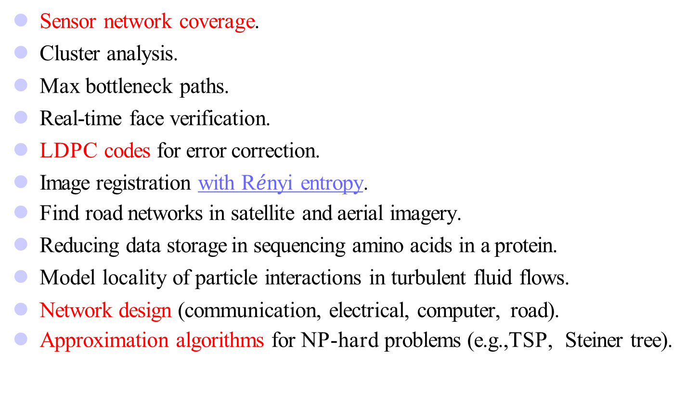
Applications of MST
Sensor network coverage.
Cluster analysis.
Max bottleneck paths.
Real-time face verification.
LDPC codes for error correction.
Image registration with R$\acute{e}$nyi entropy.
Find road networks in satellite and aerial imagery.
Reducing data storage in sequencing amino acids in a protein.
Model locality of particle interactions in turbulent fluid flows.
Network design (communication, electrical, computer, road).
Approximation algorithms for NP-hard problems (e.g.,TSP, Steiner tree).
Notes:
抖动。聚类分析。最大瓶颈路径。实时人脸验证。用于纠错的LDPC码低密度奇偶校验码图（LDPC码）。基于Renyi熵的图像配准。在卫星和航空图像中查找道路网络。减少蛋白质中氨基酸测序的数据存储。湍流中颗粒相互作用的模型局部性。网络设计（通信、电气、计算机、道路）。NP难问题的近似算法（如TSP、Steiner树）。

Slide 109
Minimum Spanning Tree Property
The greedy algorithm design strategy can be used to design an effective algorithm to construct the minimum spanning tree.
Prim algorithm and Kruskal algorithm
Both algorithms use the minimum spanning tree property:
Let G=(V, E) be a connected network, and U be a true subset of vertex set V. If (u, v) is an edge with the lowest weight value among all the edges in G where one vertex is in U (u ∈ U) and the other vertex is not in U (i.e. v ∈ V-U), then there must be a minimum spanning tree of G including this edge (u, v).

Slide 110
Minimum Spanning Tree Property
Proof of MST property：
Assuming that ：
  ① Vertex in set U - red vertex
  ② Vertex in V-U - Blue Vertex
  ③ Edge connecting red vertex and blue vertex - purple edge
  ④ The purple edge with the least weight is called the light edge (that is, the edge with the most "light" weight).
MST property can be represented :if existed a light edge, there exist a MST contains the light edge.
Proving MST Properties by contradiction

Slide 111
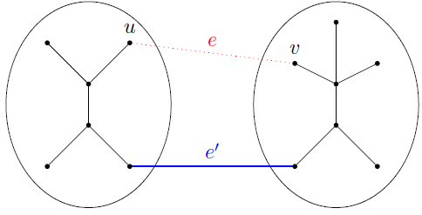
Minimum Spanning Tree Property
Suppose that any MST in G does not contain light edges (u, v). If T is an MST of G, it does not contain this light edge(u,v).
Since T is a connected graph containing all vertices in G, there must be a path P from red u to blue v in T, and there must be a purple edge (u ′, v ′) on P to connect the red vertex set and the blue vertex set, otherwise u and v are not connected. When the light edge (u, v) is added to the tree T, the light edge and P must form a loop. After removing the purple edge (u ′, v ′), the loop is also eliminated, so another tree T ′ can be obtained.

Slide 112
Minimum Spanning Tree Property
T ′ is an MST. Proof idea: compare its weight to that of T
weight(T ′) = weight(T ) + w(e) − w(e′)
Both e and e′ cross between U and V − U, and e is the lightest
w(e) ≤ w(e′) ⇒ weight(T ′) ≤ weight(T )
Then : T is an MST ⇒ weight(T ′) = weight(T ) ⇒ T ′ is also an MST and it contains light edge (u，v)，which contradicts the assumption. Therefore, the MST property is correct.

Slide 113
Prim’s Algorithm (node-by-node)
First discovered by Czech mathematician Vojtěch Jarník 1930,later rediscovered and republished by Robert C. Prim in 1957, and Edsger W. Dijkstra in 1959. Thus, also known as the DJP algorithm.
The basic idea of the Prim algorithm : first, set start vertex 1 as the red U={1}, and then, make the following greedy choices: select the light edge (i,j), and add the vertex j to U to be a new red vertex. This process continues until U=V.
All the edges selected in this process just constitute a minimum spanning tree of G.

Slide 114
Prim’s Algorithm for Finding an MST
Step 1: x ∈ V, Let A = {x}, B = V - {x}.
Step 2: Select light edge (u, v) ∈ E, u ∈ A, v ∈ B such that (u, v) has the smallest weight between A and B.
Step 3: Put (u, v) into the tree. A = A ∪ {v}, B = B - {v}
Step 4: If B = ∅, stop; otherwise, go to Step 2.
Time complexity : O(n²), n = |V|.

Slide 115
Prim（普里姆）算法
PrimMST(G，T,1)
{ T=φ；U={1};
while(U!=V) //O(V)
{ (i,j)=i∈U，j∈V-U，and (i,j) light edge//O(V)
T=T∪ (i，j) //add (i，j) to T
U=U ∪ {j}; // add j to U，to be a red j
}
}

Slide 116
Prim（普里姆）算法
如何有效地找出满足条件i∈U, j∈V-U，且权c[i][j]最小的边(i,j)？
  简单的办法是设置2个数组closest和lowcost。
  在Prim算法执行过程中，先找出V-U中使lowcost值最小的顶点j，然后根据数组closest选取边(j,closest[j］)，将j添加到U中，并对closest和lowcost作必要的修改。

Slide 117
Prim Algorithm Example
A connected weight graph is given as follows:
Let A={1}，T= Φ；
1
1
Fifth iteration：
∵(5, 2)light edge
∴ A={1, 3, 6, 4, 2, 5}，
T= {(1, 3), (3, 6), (6, 4),
(3, 2) (2, 5)} ；
Third iteration：
∵(6, 4)light edge
∴ A={1, 3, 6, 4}，
T= {(1, 3), (3, 6), (6, 4)} ；
First iteration：
∵(1, 3)light edge
∴ A={1, 3}
T= {(1, 3)} ；
Second iteration：
∵(3, 6)light edge
∴ A={1, 3, 6}，
T= {(1, 3), (3, 6)} ；
Forth iteration：
∵(2, 3)light edge
∴ A={1, 3, 6, 4, 2}，
T= {(1, 3), (3, 6), (6, 4),
(2, 3)} ；
6
5
1
2
2
4
5
5
4
3
3
3
6
4
2
6
5
5
6
6

Slide 118
Discuss on Prim’s Algorithm
How to implement it?
  Data Structure
    Graph
  How to find the light edge that connects U and V − U.
    Purple edge?
    Priority Queue
  How to locate and record the current light edge?
    The red vertex just visited

Slide 119
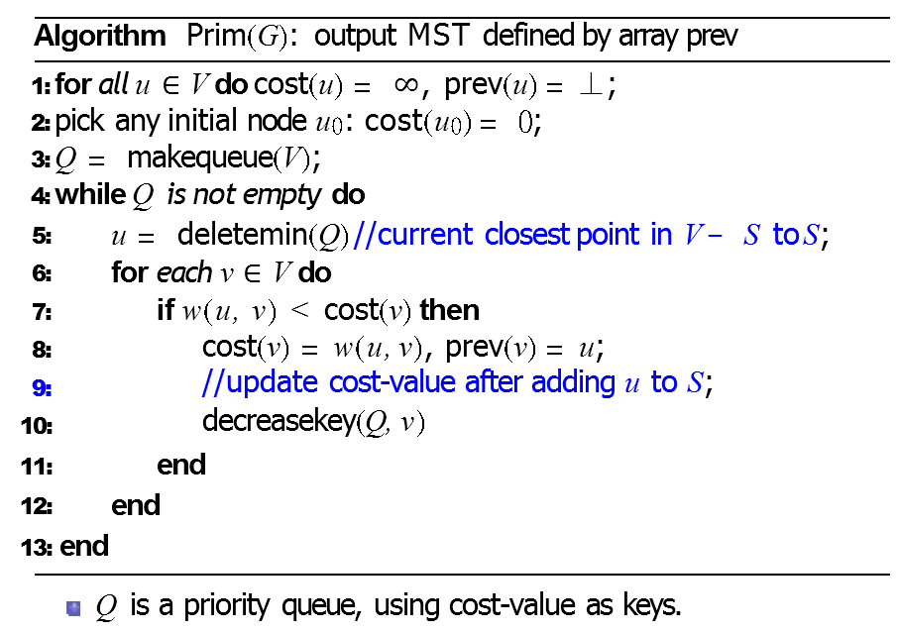
Pseudocode of Prim Algorithms
How about the complexity analysis?
  O(|E|*log|V|)
  Θ(|V|²)

Slide 120
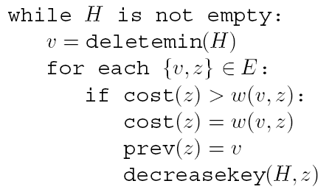
Prim’s Algorithm
Choose arbitrary starting vertex,
set to 0 and deletemin
1
2
S = {5}
1
2
3
1: ∞
2: ∞
3: ∞
4: ∞
5: 0
6: ∞
7: ∞
6
5
4
4
6
3
8
4
5
6
8
4
3
7
Notes:
Goal: Present Prim’s algorithm graphically in a manner similar to Kruskal’s algorithm.

Slide 121
Prim’s Algorithm
Choose arbitrary starting vertex,
set to 0 and deletemin
1
2
X:
S = {5}
1
2
3
1: ∞
2: 4
3: 5
4: 3
6: 8
7: 8
6
5
4
4
6
3
8
4
5
6
8
4
3
7
Notes:
Goal: Present Prim’s algorithm graphically in a manner similar to Kruskal’s algorithm. Initially, consider the light blue edges leaving 5.

Slide 122
Prim’s Algorithm
Do deletemin to
Pick shortest edge leaving S
1
2
X:
S = {5}
1
2
3
{4,5}
1: ∞
2: 4
3: 5
4: 3
6: 8
7: 8
6
5
4
4
6
3
8
4
5
6
8
4
3
7
Notes:
Greedily chosen, this edge will be part of final solution

Slide 123
Prim’s Algorithm
Don’t actually need to store S.
Current PQ is always V - S
X:
S = {5}
1
2
1: ∞
2: 4
3: 5
4: 3
6: 8
7: 8
1
2
3
{4,5}
S = {4,5}
6
5
4
4
6
3
8
4
5
6
8
4
3
7

Slide 124
Prim’s Algorithm
Update then choose shortest cost from
any node in S – node on front of PQ.
Once popped off PQ, will never be
chosen as sink of an edge
1
2
X:
S = {5}
1
2
3
{4,5}
S = {4,5}
1: 4
2: 4
3: 5
6: 8
7: 4
6
5
4
4
6
3
8
4
5
6
8
4
3
7
Notes:
NOT path length, just cheapest one edge cost
Now consider any of the blue edges leaving 4 or 5. Etc. as we add more vertices. Node 7 cost is decreased.

Slide 125
Prim’s Algorithm
Repeat until PQ is empty
X:
S = {5}
1
2
2: 1
3: 5
6: 8
7: 4
1
2
3
{4,5}
S = {4,5}
6
{1,4}
S = {1,4,5}
6
5
4
4
3
8
4
5
6
8
4
3
7

Slide 126
Prim’s Algorithm
Repeat until PQ is empty
1
2
X:
S = {5}
1
2
3
{4,5}
S = {4,5}
3: 2
6: 8
7: 4
6
5
{1,4}
S = {1,4,5}
4
4
6
{1,2}
S = {1,2,4,5}
3
8
4
5
6
8
4
3
7
Notes:
Skip this unless brought up, as it is not the best use of time.
***Note in this case when node 2 checked node 1 which has a key of 4 it would update the cost to 1 (not big deal) AND prev pointer of node 1 would change to node 2 which would be a bug.
Should only test with nodes still on the queue. If added edge immediately into X rather than prev tree at end would have been fine.

Slide 127
Prim’s Algorithm
Repeat until PQ is empty
X:
S = {5}
1
2
6: 6
7: 4
1
2
3
{4,5}
S = {4,5}
5
{1,4}
S = {1,4,5}
6
4
4
6
{1,2}
S = {1,2,4,5}
3
8
{2,3}
S = {1,2,3,4,5}
4
5
6
8
4
3
7

Slide 128
Prim’s Algorithm
Repeat until PQ is empty
X:
S = {5}
1
2
6: 3
1
2
3
{4,5}
S = {4,5}
5
{1,4}
S = {1,4,5}
6
4
4
6
{1,2}
S = {1,2,4,5}
3
8
{2,3}
S = {1,2,3,4,5}
4
5
6
{4,7}
S = {1,2,3,4,5,7}
8
4
3
7

Slide 129
Prim’s Algorithm
Repeat until PQ is empty
1
2
X:
S = {5}
1
2
3
{4,5}
S = {4,5}
6
5
{1,4}
S = {1,4,5}
4
4
6
{1,2}
S = {1,2,4,5}
3
8
{2,3}
S = {1,2,3,4,5}
4
5
6
{4,7}
S = {1,2,3,4,5,7}
8
{6,7}
S = {1,2,3,4,5,6,7}
4
3
7

Slide 130
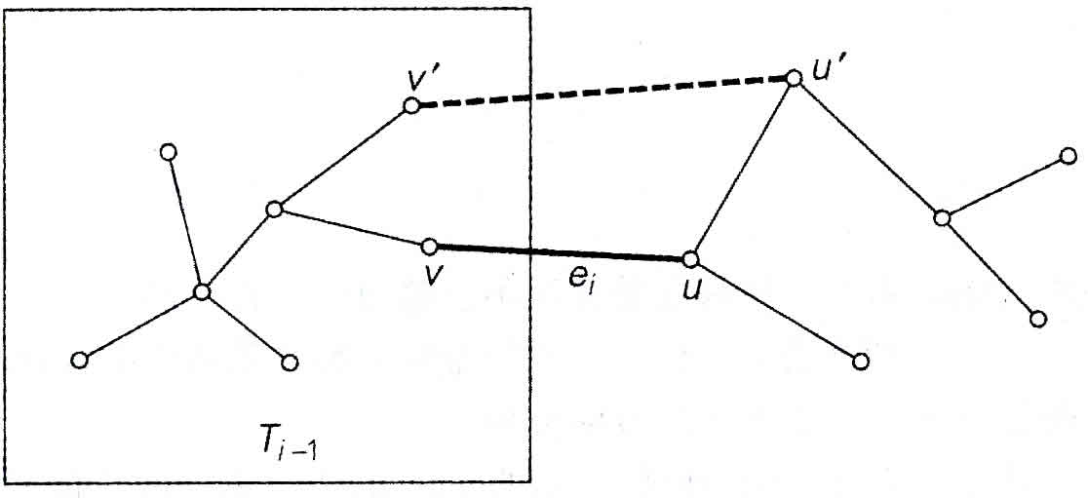
Prim算法是否能产生一个最优解
用归纳法和反证法来证明：
假设T_{i-1}是某些最小生成树T的一部分，我们需要证明，通过Prim算法从T_{i-1}生成的T_{i}也是一棵最小生成树的一部分。

Slide 131
Prim算法是否总能产生一棵最小生成树？
用数学归纳法证明：
用T_{i} ( i=0，……,n-1)
表示Prim算法过程中生成的每一棵子树。
归纳基本条件：
T₀（只含一个顶点的初始树），显然是最小生成树的一部分。
归纳步骤：
设T_{i-1} 是最小生成树T的一部分,
证明（反证法）：
用Prim算法从T_{i-1} 生成的T_{i}也是一棵最小生成树的一部分。

Slide 132
Prim算法是否总能产生一棵最小生成树？
反证法：
假设：没有一棵最小生成树包含T_{i} ,
设 e_{i}=(v,u)是从树T_{i-1}中一个顶点连接不在树T_{i-1}中的一个顶点权重最小的边。即：v属于T_{i-1} ，u不属于T_{i-1} 。
Prim算法利用e_{i}将T_{i-1}扩展到T_{i}。
之前假设e_{i}不属于包括T在内的任何一棵最小生成树。
把e_{i}加入T中，形成了回路。 （为什么？）
该回路必定包含另一边(x,y)， x属于T_{i-1} ，y不属于T_{i-1} 。
（为什么？）
如果删除该边(x,y)，得到另一棵生成树，
权重小于等于T。（为什么？）
和假设矛盾。

Slide 133
Prim算法的效率
取决于表示图的数据结构
表示V-V_{T}的优先队列的数据结构
可用的数据结构：
    图：权重矩阵
    优先队列：无序数组
  运行时间属于Θ(|V|²)
    图：邻接链表
    优先队列：最小堆
  运行时间O(|E|*log|V|)

Slide 134
Kruskal’s Algorithm (edge-by-edge)
Joseph Kruskal [American Mathematical Society, 1956]
Rough idea.
  Start with the empty graph, then select edges from E according to the following rule
    Repeatedly add the next lightest edge that doesn’t produce a cycle
Kruskal’s algorithm constructs the tree edge-by-edge, apart from taking care to avoid cycles, simply picks the cheapest edge at the moment.
This is a greedy algorithm: every decision it makes is the one with the most obvious immediate advantage.

Slide 135
Kruskal’s Algorithm for Finding MST
Input : A weighted, connected and undirected graph
G = (V, E ).
Output : A minimal spanning tree for G.
T : = φ
While T contains less than n - 1 edges do
Begin
Choose an edge (v, w) from E of the smallest weight
Delete (v, w) from E
If (the adding of (v, w) to T does not create a cycle in T) then
Add (v, w) to T
Else
Discard (v, w)
End

Slide 136
Kruskal Algorithm Example
n – 1 edges have been selected. The results are shown in the figure.
u
v
Select edge 6, and vertices 1, 3, 4, 6, 2, and 5 belong to the same set.
w
Check edge 5. Because vertices 1 and 4 belong to the same set, they are discarded.
Edge 2 is selected, so vertices 4 and 6 are merged into the same set.
Edge 1 is selected, so vertices 1 and 3 are merged into the same set.
Edge 4 is selected, so vertices 1, 3, 4, and 6 are merged into the same set
Edge 3 is selected, so vertices 2 and 5 are merged into the same set.
Initially 6 isolated points
√
1 | 3 | 1
4 | 6 | 2
2 | 5 | 3
3 | 6 | 4
1 | 4 | 5
2 | 3 | 5
3 | 4 | 5
1 | 2 | 6
3 | 5 | 6
5 | 6 | 6
√
√
1
1
√
6
5
×
1
√
2
5
5
4
2
4
3
3
3
6
4
2
6
5
6
5
6

Slide 137
Kruskal Algorithm Implementation Details
The basic idea of Kruskal algorithm is to first treat n vertices of G as n isolated connected components, and sort all edges from smallest to largest.
Select-and-Check. At each stage, the algorithm chooses an edge to add to its current partial solution.
  To do so, it needs to test each candidate edge (u, v) to see whether u and v lie in different components ⇒ otherwise the edge produces a cycle
Merge. Once an edge is chosen, the corresponding components need to be merged.
What kind a data structure supports such operations?

Slide 138
Kruskal Algorithm Implementation Details
Using the UNION and Find Set .
Initially each node is a component by itself.
  makeset(x): create a singleton set containing just x
Repeatedly test pair of nodes (vertices of candidate edge) to see if they belong to the same set.
  find(x): to which set does x belong?
Whenever we add an edge, merging two components
  union(x, y): merge the sets containing x and y

Slide 139
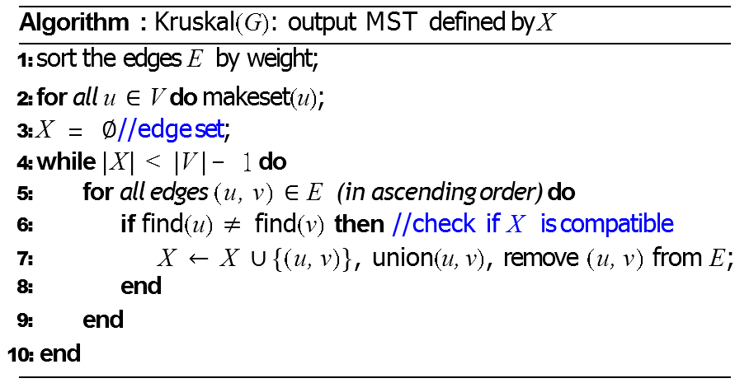
Pseudocode of Kruskal’s Algorithm
How about the proof of the algorithm?

Slide 140
Kruskal Algorithm Complexity
O(|E|log|V|) for initially sorting the edges
  Sort is actually O(|E|log|E|)
  Note that for a dense graph |E| ≈ |V|²
  But remember that logn² = 2logn so they only differ by a constant factor and thus Θ(|E|log|V|) = Θ(|E|log|E|)
O(|V|) for the initial makesets – since each is O(1)
find(u): log|V| 2|E| times: O(|E|log|V|)
union(u,v): log|V| |V|-1 times (why?) – O(|V|log|V|)
Total complexity is O(|E|log|V| + O(|V|) + |O(|E|log|V|) + O(|V|log|V|)
Total complexity: O(|E|log|V|)

Slide 141
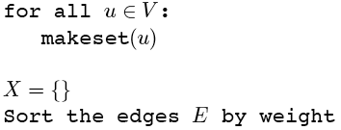
Kruskal’s Algorithm Example
Make a disjoint set for each vertex
1
2
1
2
3
{1}{2}{3}{4}{5}{6}{7}
6
5
4
4
6
3
8
4
5
6
7
4
3
7
Notes:
Each vertex goes into a separate connected component.
We'll show X on the graph (colored edges), Each color will represent a connected component

Slide 142
Kruskal’s Algorithm Example
Sort edges by weight
1
2
1
2
3
1: {1,2}
{1}{2}{3}{4}{5}{6}{7}
2: {2,3}
6
5
4
4
6
3: {4,5}
3
8
3: {6,7}
4
5
6
4: {1,4}
4: {2,5}
7
4
3
4: {4,7}
5: {3,5}
7
Notes:
Goal: Visually walk through Kruskal’s algorithm running on this simple graph. This simple enumerates the steps
starting with the sorting.

Slide 143
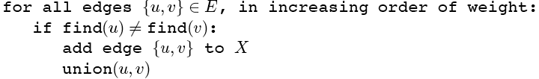
Kruskal’s Algorithm Example
Add first edge to X if no cycle created
1
2
1
2
3
1: {1,2}
{1}{2}{3}{4}{5}{6}{7}
2: {2,3}
6
5
4
4
6
3: {4,5}
3
8
3: {6,7}
4
5
6
4: {1,4}
4: {2,5}
7
4
3
4: {4,7}
5: {3,5}
7
Notes:
Add the edge with the lowest cost to the solution set X which does not create a cycle.

Slide 144
Kruskal’s Algorithm Example
Merge vertices in added edges
1
2
1
2
3
1: {1,2}
{1,2}{3}{4}{5}{6}{7}
2: {2,3}
6
5
4
4
6
3: {4,5}
3
8
3: {6,7}
4
5
6
4: {1,4}
4: {2,5}
7
4
3
4: {4,7}
5: {3,5}
7
Notes:
The two vertices that are in the edge are merged into the same connected component

Slide 145
Kruskal’s Algorithm Example
Process each edge in order
1
2
1
2
3
1: {1,2}
{1,2}{3}{4}{5}{6}{7}
2: {2,3}
{1,2,3}{4}{5}{6}{7}
6
5
4
4
6
3: {4,5}
3
8
3: {6,7}
4
5
6
4: {1,4}
4: {2,5}
7
4
3
4: {4,7}
5: {3,5}
7
Notes:
The next following slides show who each edge is added to T. The issue of always merging separate connected
Components is delayed until we try to add an edge that creates a cycle.

Slide 146
Kruskal’s Algorithm Example
1
2
1
2
3
1: {1,2}
{1,2}{3}{4}{5}{6}{7}
2: {2,3}
{1,2,3}{4}{5}{6}{7}
6
5
4
4
6
3: {4,5}
{1,2,3}{4,5}{6}{7}
3
8
3: {6,7}
4
5
6
4: {1,4}
4: {2,5}
7
4
3
4: {4,7}
5: {3,5}
7
Note that each set is a connected component of G
Notes:
different color for each non-singleton set/connected component

Slide 147
Kruskal’s Algorithm Example
1
2
1
2
3
1: {1,2}
{1,2}{3}{4}{5}{6}{7}
2: {2,3}
{1,2,3}{4}{5}{6}{7}
6
5
4
4
6
3: {4,5}
{1,2,3}{4,5}{6}{7}
3
8
3: {6,7}
{1,2,3}{4,5}{6,7}
4
5
6
4: {1,4}
4: {2,5}
7
4
3
4: {4,7}
5: {3,5}
7

Slide 148
Kruskal’s Algorithm Example
1
2
1
2
3
1: {1,2}
{1,2}{3}{4}{5}{6}{7}
2: {2,3}
{1,2,3}{4}{5}{6}{7}
6
5
4
4
6
3: {4,5}
{1,2,3}{4,5}{6}{7}
3
8
3: {6,7}
{1,2,3}{4,5}{6,7}
4
5
6
4: {1,4}
{1,2,3,4,5}{6,7}
4: {2,5}
7
4
3
4: {4,7}
5: {3,5}
7

Slide 149
Kruskal’s Algorithm Example
Must join separate components
1
2
1
2
3
1: {1,2}
{1,2}{3}{4}{5}{6}{7}
2: {2,3}
{1,2,3}{4}{5}{6}{7}
6
5
4
4
6
3: {4,5}
{1,2,3}{4,5}{6}{7}
3
8
3: {6,7}
{1,2,3}{4,5}{6,7}
4
5
6
4: {1,4}
{1,2,3,4,5}{6,7}
4: {2,5}
rejected
7
4
3
4: {4,7}
5: {3,5}
7
Notes:
Note that this edge would create a cycle, so it is rejected and not part of T.

Slide 150
Kruskal’s Algorithm Example
1
2
1
2
3
1: {1,2}
{1,2}{3}{4}{5}{6}{7}
2: {2,3}
{1,2,3}{4}{5}{6}{7}
6
5
4
4
6
3: {4,5}
{1,2,3}{4,5}{6}{7}
3
8
3: {6,7}
{1,2,3}{4,5}{6,7}
4
5
6
4: {1,4}
{1,2,3,4,5}{6,7}
4: {2,5}
rejected
7
4
3
4: {4,7}
{1,2,3,4,5,6,7} done
5: {3,5}
7
Notes:
This version of Kruskals will not terminate early but continue until all edges are tried

Slide 151
Union-Find Algorithm Implementation
Each set is represented by a "rooted tree“
Define an array set [1.. N]
  Set [i]=i, then i represents this set and is the root of the tree corresponding to the set
  Set [i]=j, j<>i, then j is the parent node of i
2
1
3
4
5
7
10
6
8
9
i
1 | 2 | 3 | 4 | 5 | 6 | 7 | 8 | 9 | 10
1 | 2 | 3 | 2 | 1 | 3 | 4 | 3 | 3 | 4
Set(i)
How about the typical operations of the union-find set algorithm?

Slide 152
Union-Find Algorithm Assignment
课外思考题
在某个城市里住着n个人，任何两个认识的人不是朋友就是敌人，而且满足：
    我朋友的朋友是我的朋友；
    我敌人的敌人是我的朋友；
已知关于 n个人的m条信息（即某2个人是朋友或者敌人），假设所有是朋友的人一定属于同一个团伙，请计算该城市最多有多少团伙？

Slide 153
Kruskal算法的正确性证明
命题：对于任意 n, 该算法对 n 阶图得到一棵最小生成树.
证明 n=2, 只有一条边，命题显然为真.
假设对于n个顶点的图算法正确，考虑n+1个顶点的图G, G中最小权边 e = {i, j}，从G 中短接 i 和 j（合并为一个顶点），得到图G’. 根据归纳假设，由算法存在G’ 的最小生成树T’.令T=T ’∪{e}, 则T 是关于G 的最小生成树.
否则存在G 的含边e 的最小生成树T*，W(T*)<W(T). (含e的反证：如果 e ∉T*, 在T*中加边e，形成回路. 去掉回路中任意别的边所得生成树的权更小，矛盾). 在T*中短接 e 得到G’ 的生成树T*−{e}, 且
W(T*−{e})=W(T*)−w(e)<W(T)−w(e )=W(T’)，
与T’ 的最优性矛盾.

Slide 154
Time complexity
Time complexity: O(|E| log|E|)
  Step 1: O(|E| log|E|)
  Step 2 & Step 3:
  Where α is the inverse of Ackermann’s function.

Slide 155
Ackermann’s function
⇒ A(p, q+1) > A(p, q), A(p+1, q) > A(p, q)
65536 two’s

Slide 156
Inverse of Ackermann’s function
α(m, n) = min{i≥1|A(i, ⎣m/n⎦) > log₂n}
Practically, A(3,4) > log₂n
⇒α(m, n) ≤ 3
⇒α(m, n) is almost a constant.

Slide 157
Time Complexity of Kruskal’s Algorithm
Time complexity:
O(|E|log|E|) = O(n²logn), where n = |V|.

Slide 158
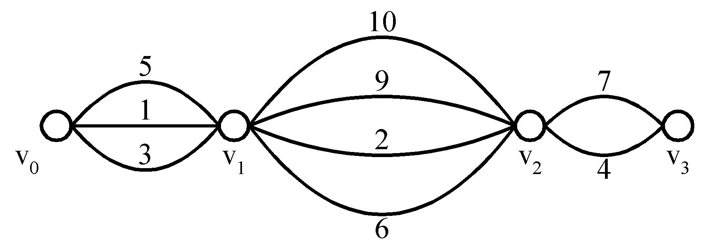
7.2.6 Shortest Paths on a Special Graph
Problem: Find a shortest path from v₀ to v₃.
The greedy method can solve this problem.
The shortest path: 1 + 2 + 4 = 7.

Slide 159
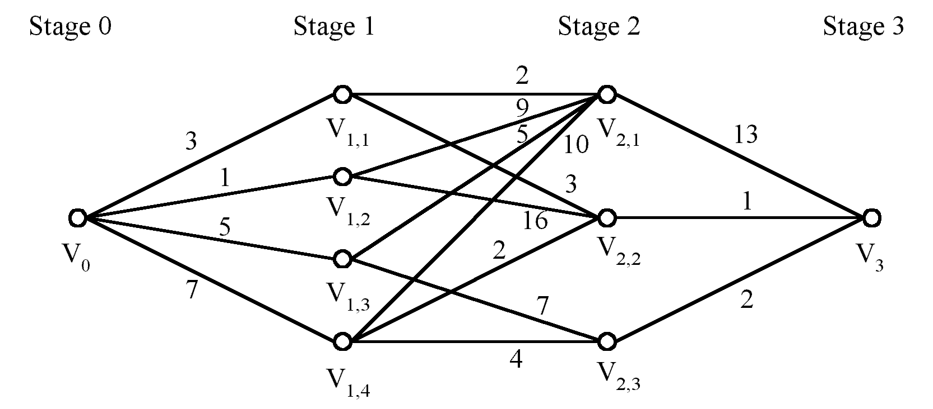
Shortest Paths on a Multi-stage Graph
Problem: Find a shortest path from v₀ to v₃ in a multi-stage graph.
Greedy method: v₀v_{1,2}v_{2,1}v₃ = 23
Optimal: v₀v_{1,1}v_{2,2}v₃ = 7
The greedy method does not work.
This problem can be solved by the dynamic programming method.

Slide 160
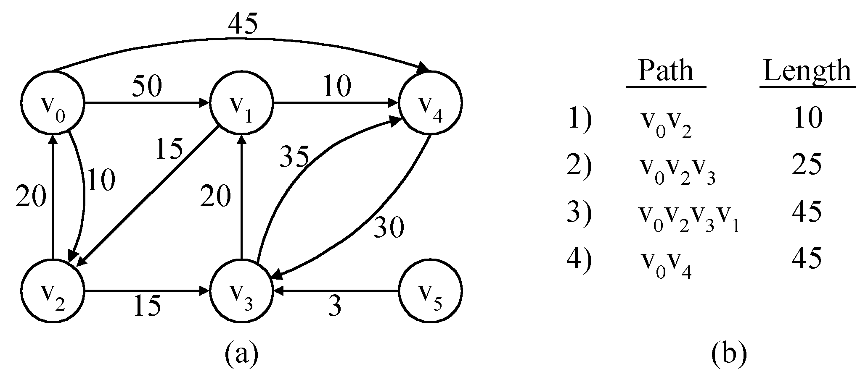
The Single-Source Shortest Path Problem
Shortest paths from v₀ to all destination nodes inside G (SSSP).

Slide 161
Applications of SSSP
Wide applications in the real world
Map routing in GIS.
Seam carving in Image Processing.
Robot navigation.
Texture mapping in Image Processing.
Typesetting in LaTeX.
Urban traffic planning.
Telemarketer operator scheduling.
Routing of telecommunications messages.
Network routing protocols (OSPF, BGP, RIP).
Optimal truck routing through given traffic congestion pattern.
Notes:
地图路由（GIS）。接缝裁剪。机器人导航。纹理贴图。LaTeX中的排版。城市交通规划。电话营销运营商调度。电信消息的路由。网络路由协议（OSPF、BGP、RIP）。通过给定交通拥堵模式的最佳卡车路线。

Slide 162
Dijkstra’s Algorithm
Edsger Wybe Dijkstra was a Dutch systems scientist, programmer, software engineer, science essayist, and pioneer in computing science.
Algorithmic work
Compiler construction and programming language research,
Programming paradigm and methodology
Operating system research
Concurrent computing and programming
Distributed computing
Formal specification and verification

Slide 163
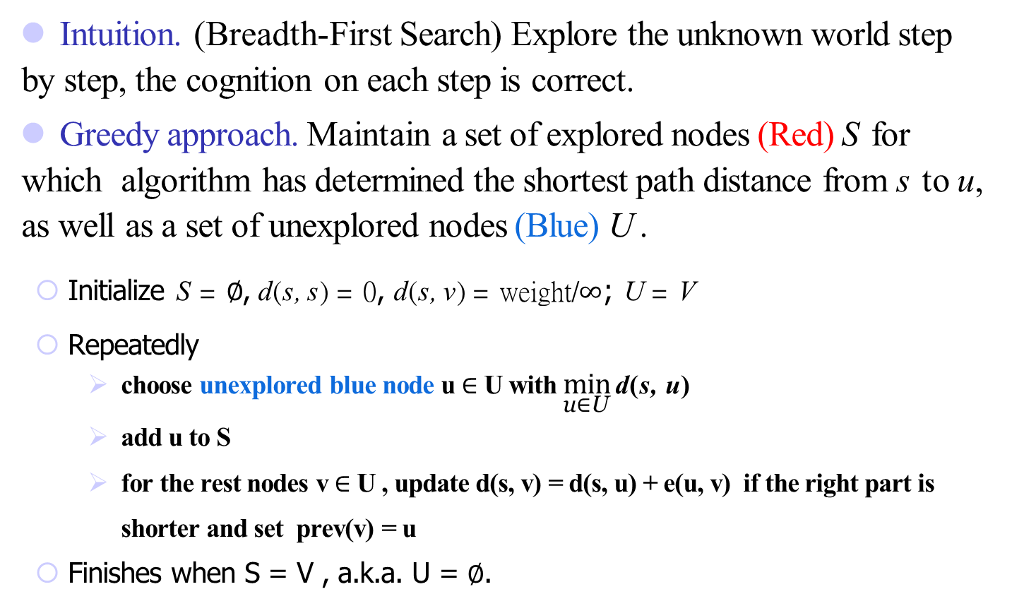
Dijkstra’s Algorithm
Intuition. (Breadth-First Search) Explore the unknown world step by step, the cognition on each step is correct.
Greedy approach. Maintain a set of explored nodes (Red) S for which algorithm has determined the shortest path distance from s to u, as well as a set of unexplored nodes (Blue) U .
  Initialize S = ∅, d(s, s) = 0, d(s, v) = weight/∞; U = V
  Repeatedly
    choose unexplored blue node u $∈$ U with $\min_{\text{u}\text{∈}\text{U}}{\text{d}\text{(}\text{s}\text{, }\text{u}\text{)} }$
    add u to S
    for the rest nodes v $∈$ U , update d(s, v) = d(s, u) + e(u, v) if the right part is shorter and set prev(v) = u
  Finishes when S = V , a.k.a. U = ∅.

Slide 164
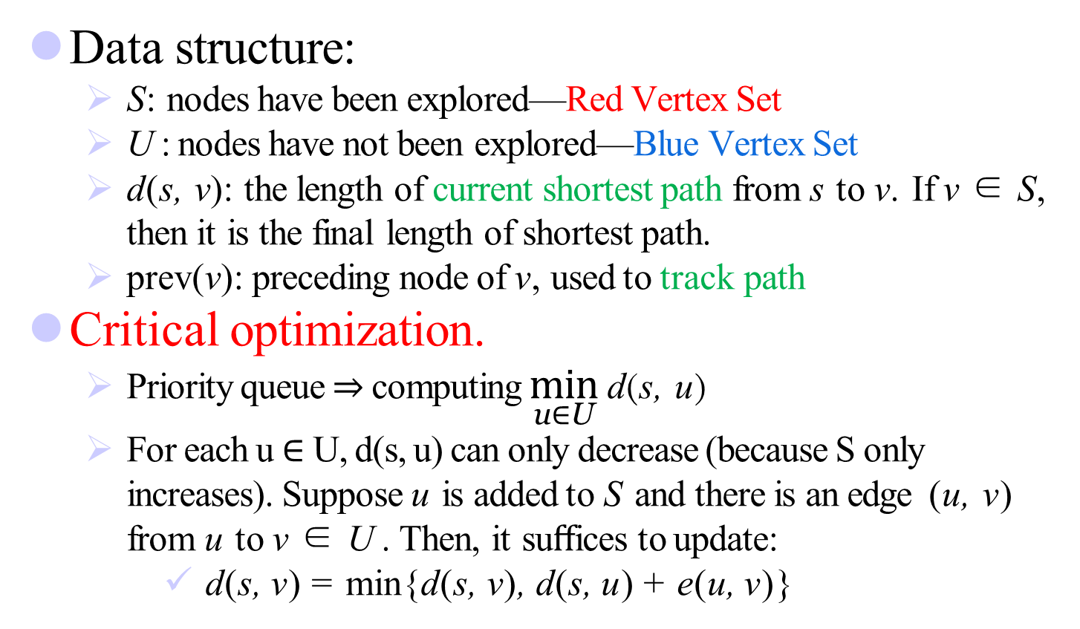
Implement Details
Data structure:
  S: nodes have been explored—Red Vertex Set
  U : nodes have not been explored—Blue Vertex Set
  d(s, v): the length of current shortest path from s to v. If v ∈ S, then it is the final length of shortest path.
  prev(v): preceding node of v, used to track path
Critical optimization.
  Priority queue ⇒ computing $\min_{\text{u}\text{∈}\text{U}}{\text{d}\text{(}\text{s}\text{, }\text{u}\text{)} }$
  For each u $∈$ U, d(s, u) can only decrease (because S only increases). Suppose u is added to S and there is an edge (u, v) from u to v ∈ U . Then, it suﬀices to update:
  d(s, v) = min{d(s, v), d(s, u) + e(u, v)}

Slide 165
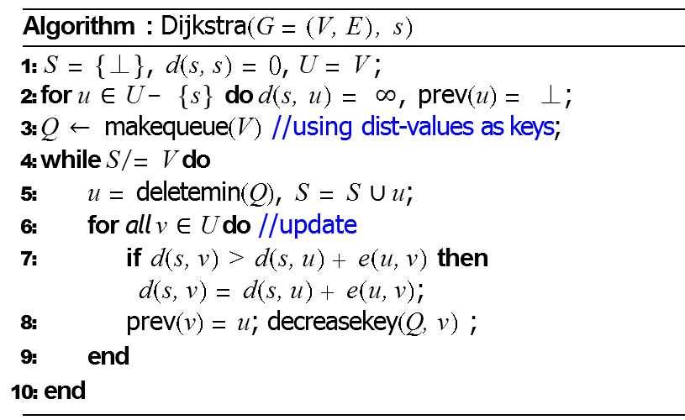
Dijkstra’s Algorithm to SSSP
Dijkstra’s algorithm works correctly for both directed and undirected graphs provided that there is no negative edges

Slide 166
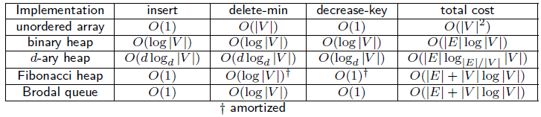
Dijkstra’s algorithm: Which priority queue?
Cost of priority queue operations.
|V | insert, |V | delete-min, O(|E|) decrease-key
Performance: depends heavily on priority queue implementation
  Array implementation optimal for dense graphs.
  Binary heap much faster for sparse graphs.
  4-way heap worth the trouble in performance-critical situations.
  Fibonacci/Brodal best in theory, but not worth implementing.
Notes:
decrease-key给定一个key，你要修改其key值，再对修改后的priority-queue的堆进行修改，使其再次成为小顶堆
In an implementation of Dijkstra's algorithm that reinserts nodes into the priority queue with their new priorities, one node is added to the priority queue for each of the m edges in the graph. This means that there are m enqueue operations and m dequeue operations on the priority queue, giving a total runtime of O(m T_{e} + m T_{d}), where T_{e} is the time required to enqueue into the priority queue and T_{d} is the time required to dequeue from the priority queue.

Slide 167
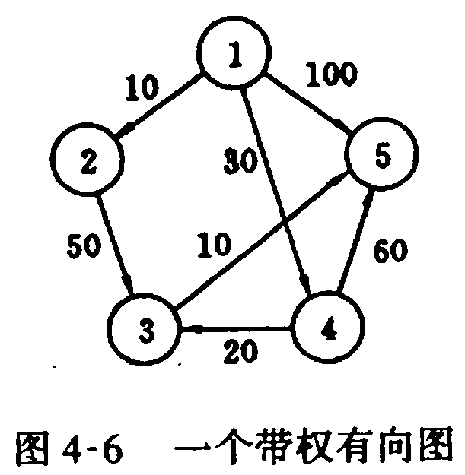
Dijkstra’s algorithm Example
1) v1 → v2: 10
2) v1 → v3: 50
3) v1 → v4: 30
4) v1 → v5: 60
课外思考题：算法正确性的证明
Notes:
1地作贪心选择来扩充这个集合。一个顶点属于集合S当且仅当从源到该顶点的最短
i已知。初始时，S中仅含有源。设2J是G的某一个顶点，我们把从源到以且中间只经过
；的路称为从源到u的特殊路径，并用数组dist来记录当前每个顶点所对应的最短特殊
＼Dijkstra算法每次从y—S中取出具有最短特殊路长度的顶点c4，将“添加到S中，
[组dist作必要的修改。一旦S包含了所有y中顶点，dist就记录了从源到所有其他顶
y最短路径长度。
stra算法可描述如下，其中输入的带权有向图是G=(y，正)，y二11，2…，，2}，顶点
：是一个二维数组，cC 2，)[川表示边(2·，了)的权。当(2·，了)务正时，c㈠)[川是一个大数。
乏示当前从源到顶点I，的最短特殊路径长
即按路径长度顺序产生最短路径.

Slide 168
Extensions of Dijkstra’s algorithm
Dijkstra’s algorithm and proof extend to several related problems:
  Shortest paths in undirected graphs
  Maximum capacity paths
  Maximum reliability paths

Slide 169
Dijkstra算法正确性证明
命题：当算法进行到第 k 步时，对于S 中每个结点 i，
dist[i] = short[i]
归纳基础 k=1, S={s}, dist[s]=short[s]=0, 命题为真.
归纳步骤 假设命题对于k 为真. 考虑 k+1步, 选择顶点v (边
{u,v}). 假若存在另一条 s-v 路径 L (绿色)，最后一次出S 的
顶点为 x, 在这次从S 中出来后
经过V−S 的第一个顶点为 y(选y).
dist[y]本来就比dit[v]大，而且要加上yv距离才是最短路径长度，与L为最短路径矛盾。因此dist[v]必然为short[v]
S
x
L
y
s
u
dist[v]=short[v]
T(n)=O(n²)
v

Slide 170
Time complexity of Dijkstra’s algorithm is O(n²).
It is optimal.

Slide 171
课堂练习题：选址问题
给定n个小区之间的交通图。若小区i与小区j之间有路可通，则将顶点i与顶点j之间用边连接，边上的权值 表示这条道路的长度。现在打算在这n个小区中选定一个小区建一所医院。
试问这家医院应建在哪个小区，才能使距离医院最远的小区到医院的路程最短？请设计一 个算法求解上述问题。

Slide 172
课堂练习题：选址问题
将n个小区的交通图视为一张带权无向图，并利用邻接矩阵来存放带权无向图。算法的思想是：
①应用Dijkstra算法计算每对顶点之间的最短路径；
②找出从每一个顶点到其它各顶点的最短路径中最长路径；
③在这n条最长路径中找出最短的一条，则它的出发点即为所求。
ANY OTHER IDEA?

Slide 173
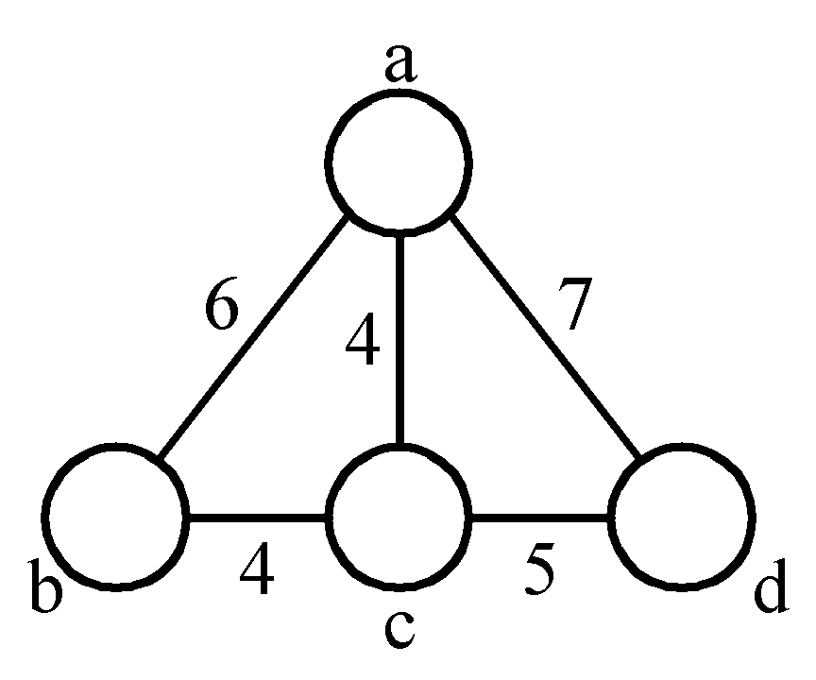
7.2.6 The minimal cycle basis problem
3 cycles:
A₁ = {ab, bc, ca}
A₂ = {ac, cd, da}
A₃ = {ab, bc, cd, da}
where A₃ = A₁ ⊕ A₂
(A ⊕ B = (A∪B)-(A∩B))
A₂ = A₁ ⊕ A₃
A₁ = A₂ ⊕ A₃
Cycle basis: {A₁, A₂} or {A₁, A₃} or {A₂, A₃}

Slide 174
7.2.6 The minimal cycle basis problem
Def: A cycle basis of a graph is a set of cycles such that every cycle in the graph can be generated by applying ⊕ on some cycles of this basis.
The weighted cycle basis problem:
Given a graph, find a minimal cycle basis of this graph.

Slide 175
7.2.6 The minimal cycle basis problem
The minimal cycle basis is {A₁, A₂}, where A₁={ab, bc, ca} and A₂= {ac, cd, da}.

Slide 176
7.2.6 The minimal cycle basis problem
A greedy algorithm for finding a minimal cycle basis:
  Step 1: Determine the size of the minimal cycle basis, denoted as k.
  Step 2: Find all of the cycles. Sort all cycles by weights.
  Step 3: Add cycles to the cycle basis one by one. Check if the added cycle is a combination of some cycles already existing in the basis. If yes, delete this cycle.
  Step 4: Stop if the cycle basis has k cycles.

Slide 177
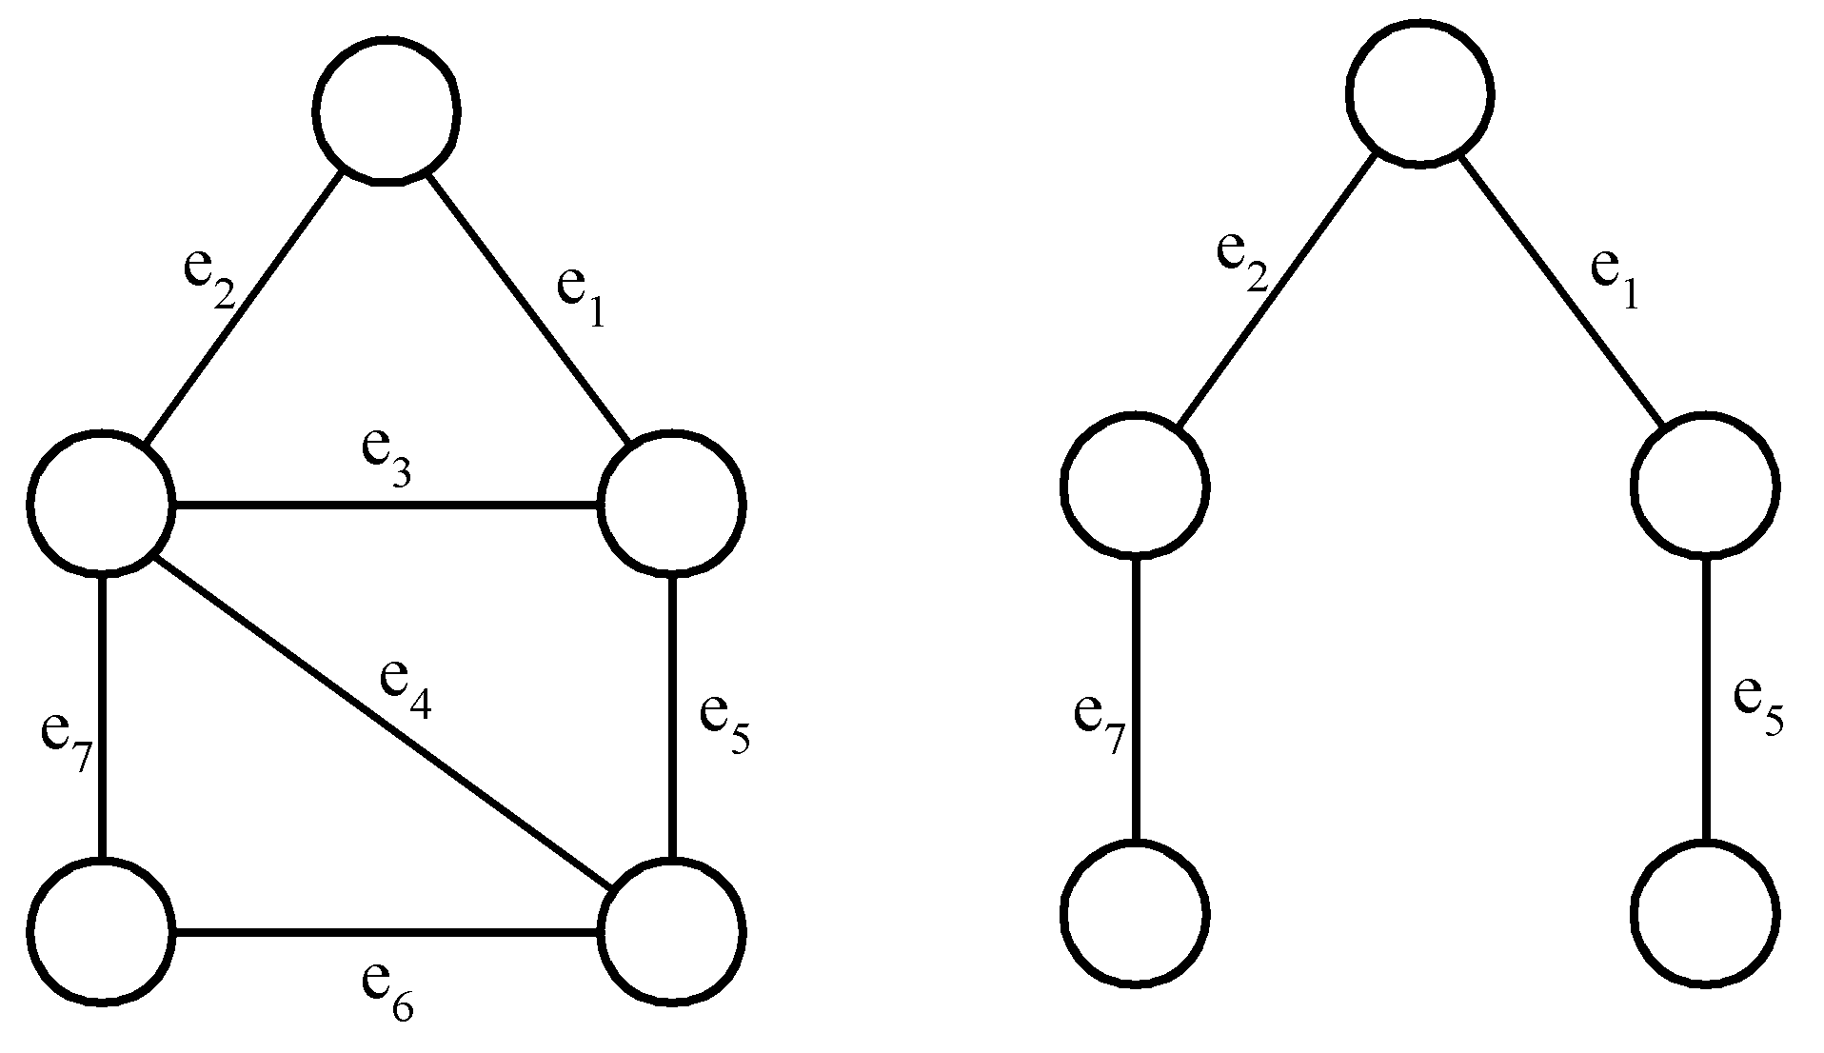
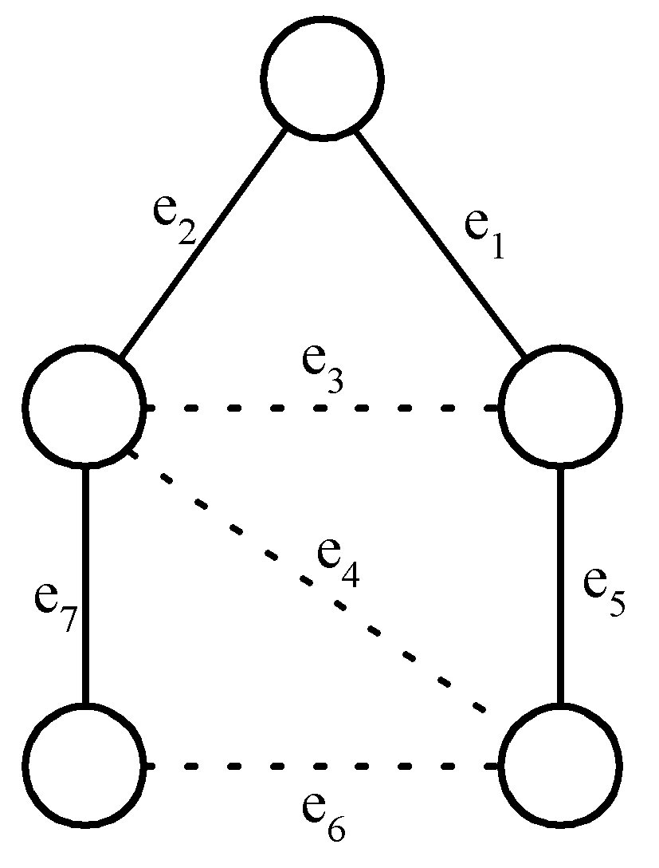
Detailed Steps for the Minimal Cycle Basis Problem
Step 1 :
A cycle basis corresponds to the fundamental set of cycles with respect to a spanning tree.
a graph
a spanning tree
a fundamental set of cycles
# of cycles in a cycle basis:
= k
= |E| - (|V|- 1)
= |E| - |V| + 1

Slide 178
Step 2:
How to find all cycles in a graph?
[Reingold, Nievergelt and Deo 1977]
How many cycles are there in a graph in the worst case?
In a complete digraph of n vertices and n(n-1) edges:
Step 3:
  How to check if a cycle is a linear combination of some cycles?
  Using Gaussian elimination.

Slide 179
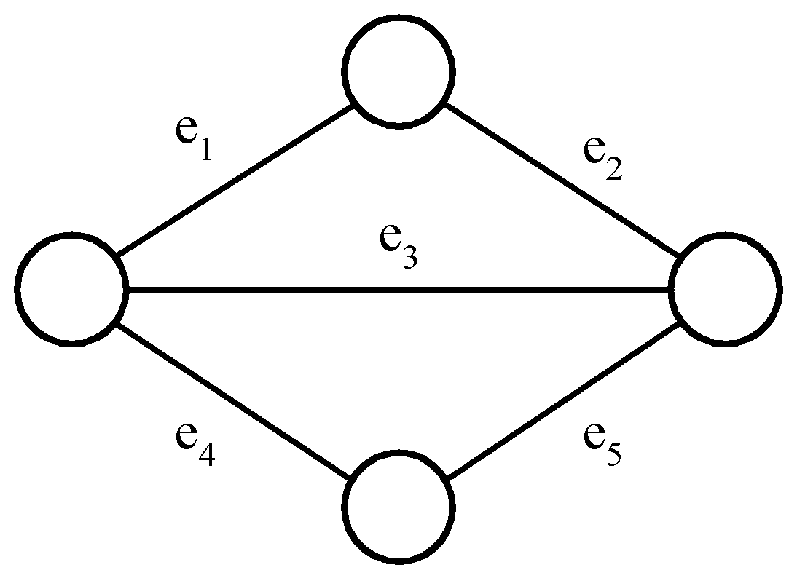
Gaussian elimination
2 cycles C₁ and C₂ are represented by a 0/1 matrix
E.g.
⊕ on rows 1 and 3
Add C₃
on rows 2 and 3 : empty
∵C₃ = C₁ ⊕ C₂

Slide 180
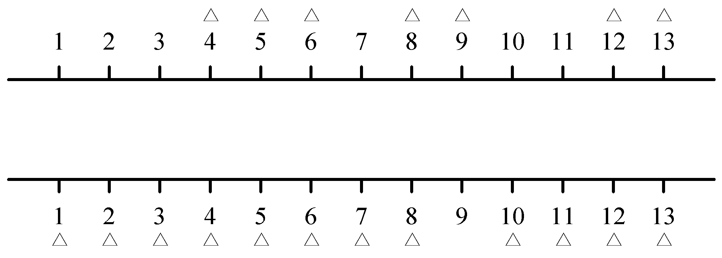
7.2.7 The 2-terminal One to Any Special Channel Routing Problem
Def: Given two sets of terminals on the upper and lower rows, respectively, we have to connect each upper terminal to the lower row in a one-to-one fashion. This connection requires that the number of tracks used is minimized.

Slide 181
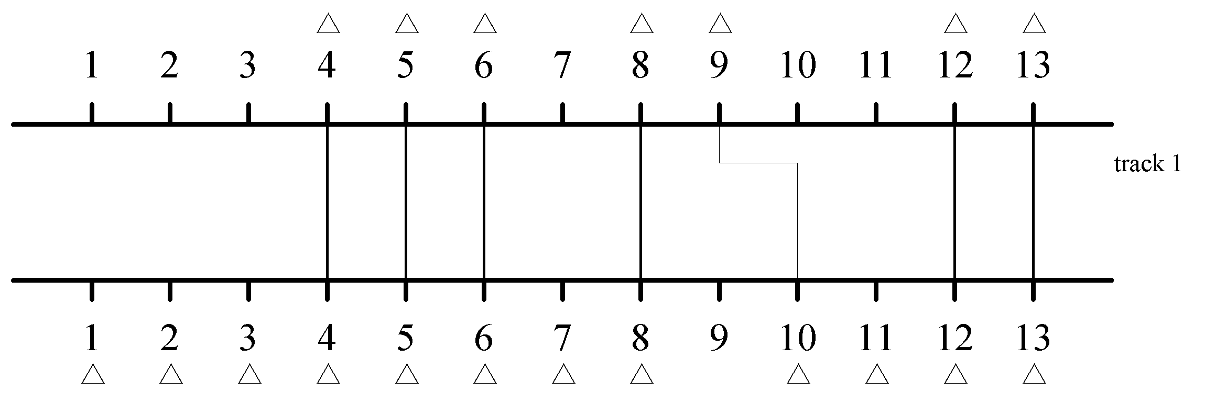
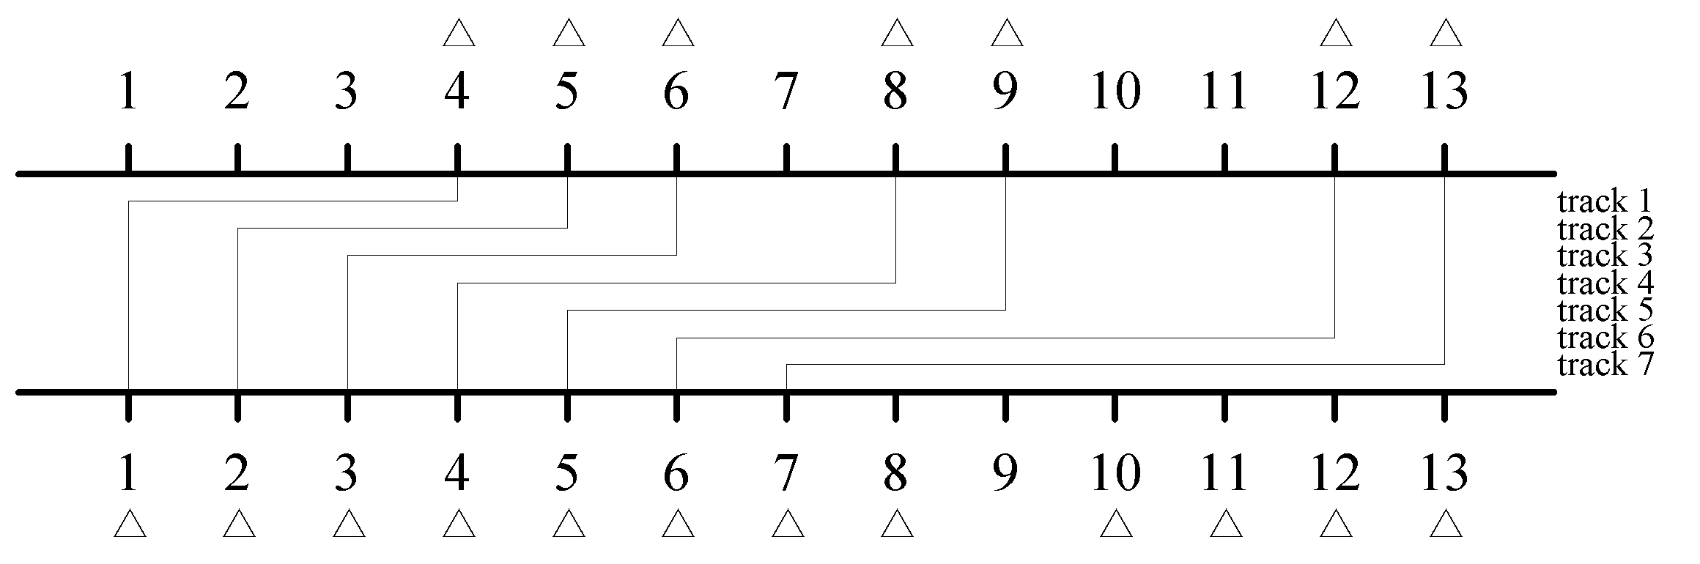
Two Feasible Solutions

Slide 182
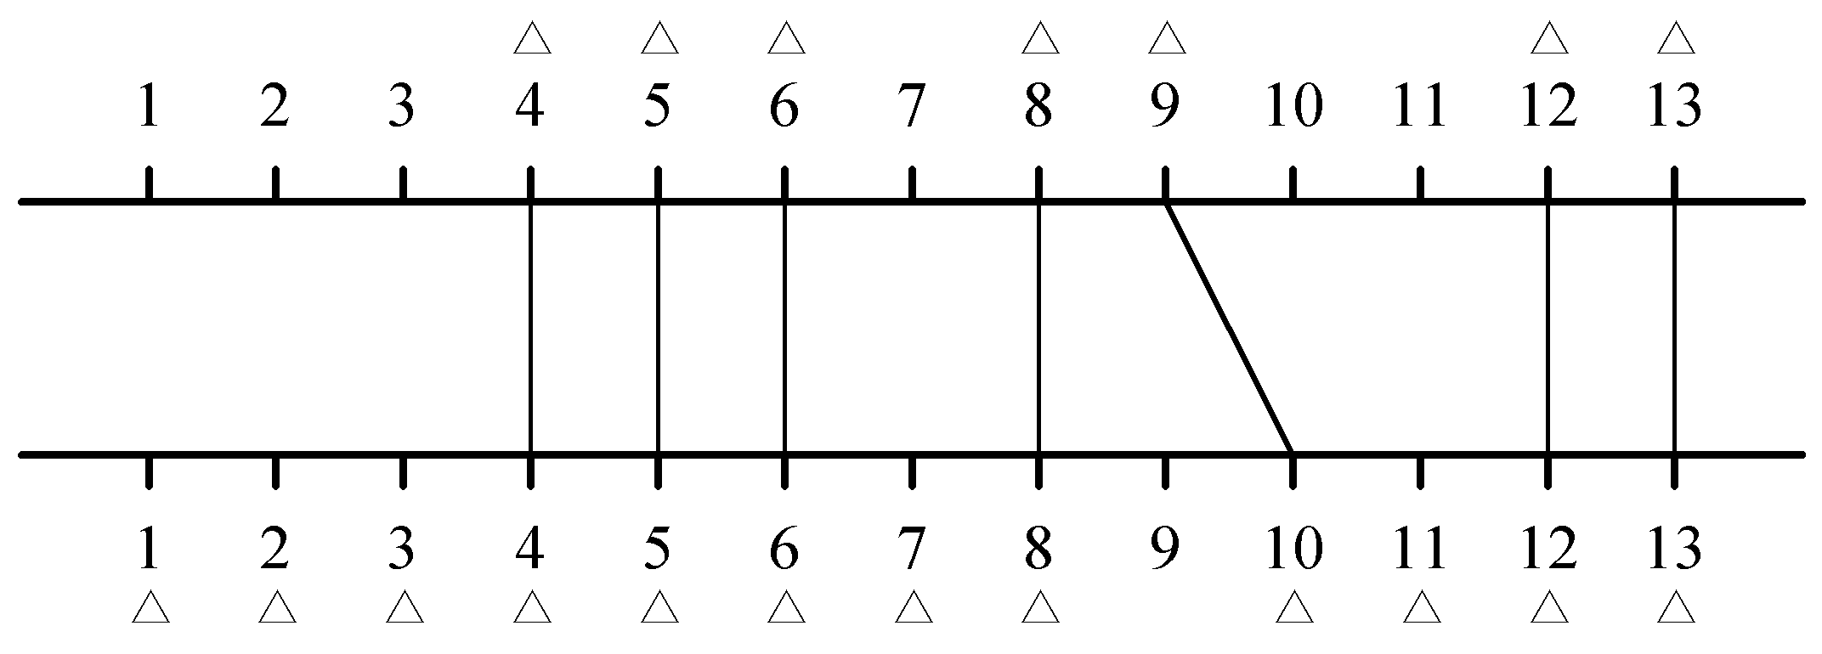
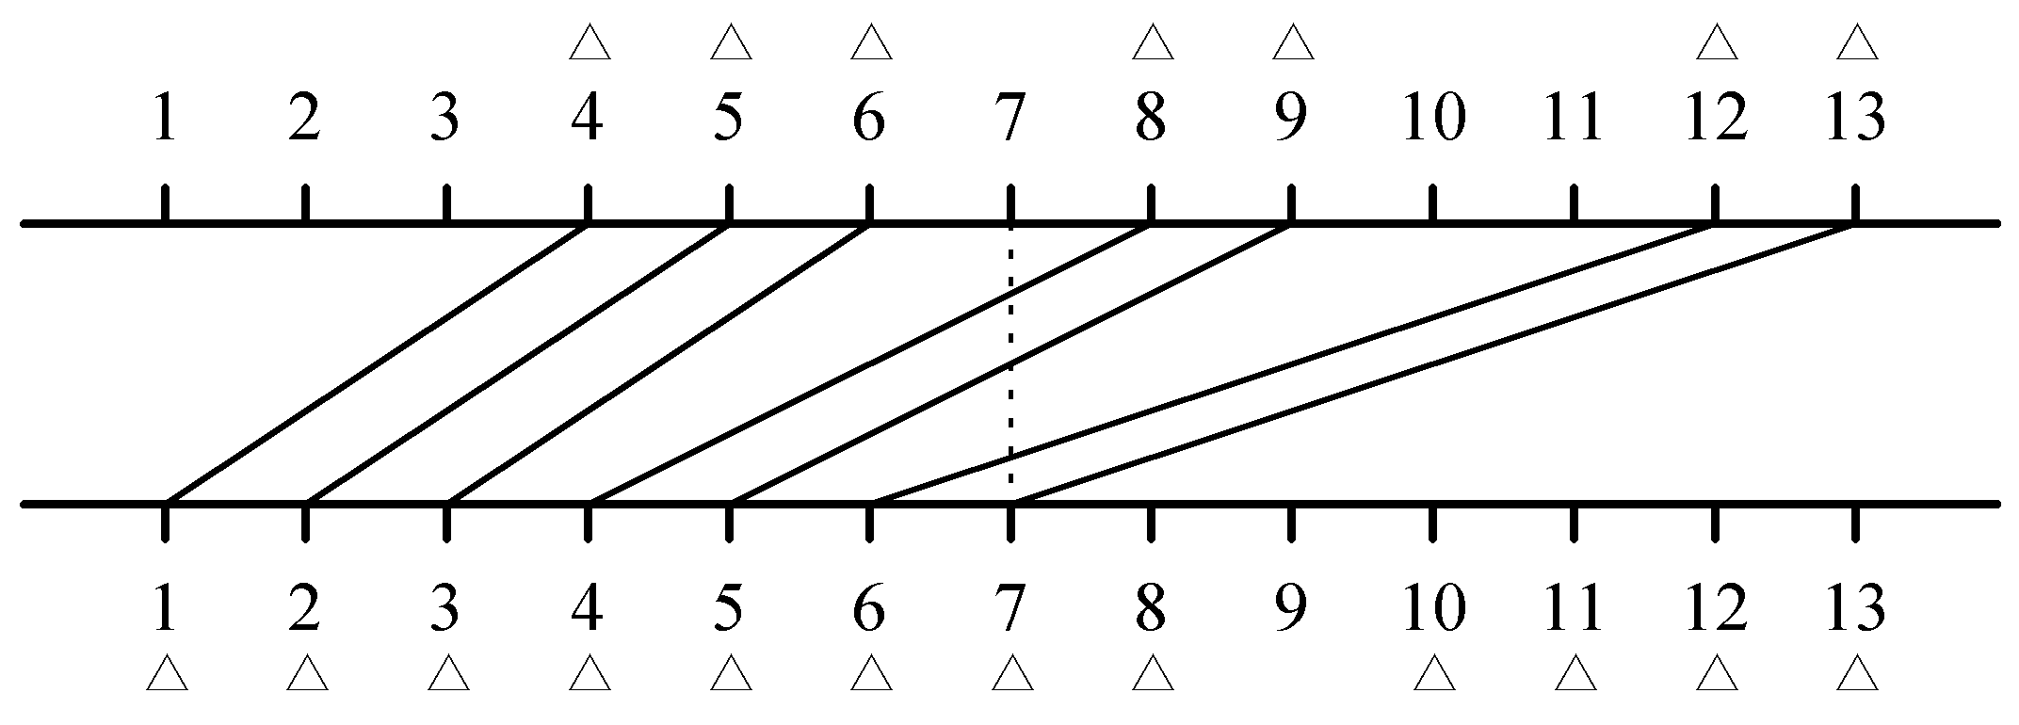
Redrawing Solutions
(a) Optimal solution
(b) Another solution

Slide 183
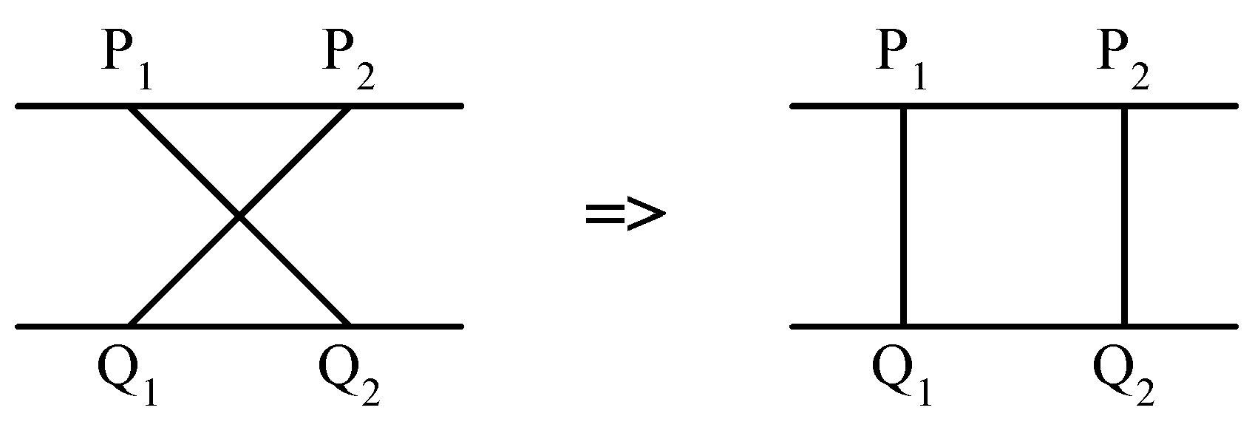
7.2.7 The 2-terminal One to Any Special Channel Routing Problem
At each point, the local density of the solution is the number of lines the vertical line intersects.
The problem: to minimize the density. The density is a lower bound of the number of tracks.
Upper row terminals: P₁ ,P₂ ,…, P_{n} from left to right.
Lower row terminals: Q₁ ,Q₂ ,…, Q_{m} from left to right m > n.
It would never have a crossing connection:

Slide 184
7.2.7 The 2-terminal One to Any Special Channel Routing Problem
Suppose that we have the minimum density d of a problem instance. We can use the following greedy algorithm:
Step 1 : P₁ is connected Q₁.
Step 2 : After P_{i} is connected to Q_{j}, we check whether P_{i+1} can be connected to Q_{j+1}. If the density is increased to d+1, try to connect P_{i+1} to Q_{j+2}.
Step 3 : Repeat Step2 until all P_{i}’s are connected.

Slide 185
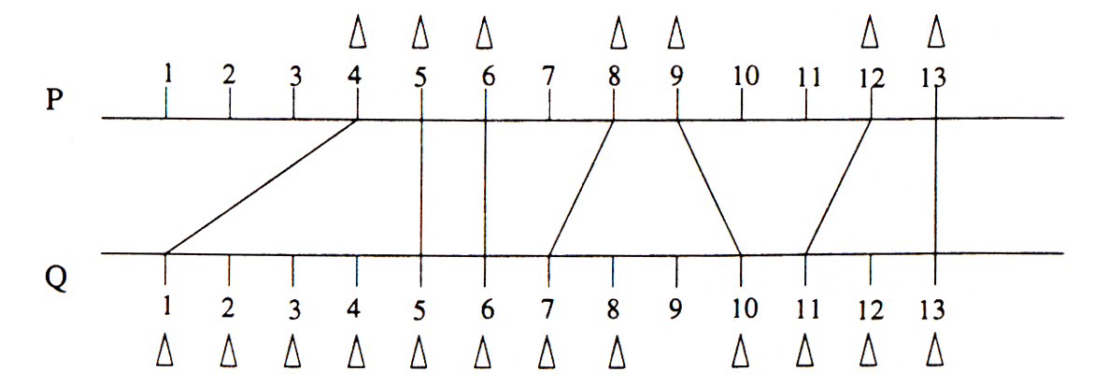
d=1
A Solution Produced by the Greedy Algorithm.

Slide 186
Road Trip Problem

Slide 187
Road Trip Problem(课外思考题）
Problem Statement
You purchase a new car. On your semester break, you decide to take a road trip from Peshawar to Karachi.
Your car has a tank of some capacity such that only a distance N km can be traveled before refilling the tank.
Suppose there are filling stations at distances of
d₀ < d₁ < d₂ < . . . < d_{n}
where d_{n} is the total distance of your trip.
Your goal is to find the smallest number of stops required i.e. shortest subsequence of <d₀ · · · d_{n}>, given that you start at d₀ and end at d_{n}.

Slide 188
Road Trip Problem
INPUT:
The max distance d_{n}, along with the distances: d₀, d₁, . . . ,d_{n}.
GOAL:
To find a smallest sub sequence of d₀, … , d_{n} so that you can start from d₀ and end at d_{n}.
Note
Greedy approach is considered each d_{i} in order.
We stop to refuel at d_{i} only if the tank will finish before we get to d_{i+1}.

Slide 189
始点到终点的距离小于Ｎ，则加油次数k=0；
始点到终点的距离大于N，
  A 加油站间的距离相等，即ａ[i]=a[j]=L=N，则加油次数最少k=n；
  B 加油站间的距离相等，即ａ[i]=a[j]=L>N，则不可能到达终点；
  C 加油站间的距离相等，即ａ[i]=a[j]=L<N，则加油次数k=n/N(n%N==0)或k=[n/N]+1(n%N！=0)；
  D 加油站间的距离不相等，即ａ[i]！=a[j]，则加油次数k通过以下算法求解。
      可以假设不到万不得已我们不加油，即除非我们油箱里的油不足以开到下一个加油站，我们才加一次油。在局部找到一个最优的解。却每加一次油我们可以看作是一个新的起点，用相同的递归方法进行下去。

Slide 190
Road Trip Problem
Greedy algorithm
for i = 1 to n do
if d_{i} - d_{i-1} > k then “do not use this car”
S = d₀
last = d₀ (the distance of the last item in S)
d_{n+1} =∞ (forces d_{n} to be in S)
for i = 1 to n do
if d_{i+1} - last > k then
S := S ∪ d_{i}
last := d_{i}

Slide 191
7.2.8 多机调度问题
多机调度问题要求给出一种作业调度方案，使所给的n个作业在尽可能短的时间内由m台机器加工处理完成。
这个问题是NP完全问题，到目前为止还没有有效的解法。对于这一类问题,用贪心选择策略有时可以设计出较好的近似算法。
约定，每个作业均可在任何一台机器上加工处理，但未完工前不允许中断处理。作业不能拆分成更小的子作业。

Slide 192
多机调度问题
核心：找准贪心策略
贪心策略：最长处理时间作业优先，即把处理时间最长的作业分配给最先空闲的机器，保证处理时间长的作业优先处理，从而在整体上获得尽可能短的处理时间。
按此策略，当 时，只要将机器i的[0, t_{i}]时间区间分配给作业i即可，算法只需要O(1)时间。
当 时，首先将n个作业依其所需的处理时间从大到小排序。然后依此顺序将作业分配给空闲的处理机。算法所需的计算时间为O(nlogn)。

Slide 193
例如，有7个独立的作业{1,2,3,4,5,6,7}，由3台机器{1,2,3}加工处理，各作业所需的处理时间如表所示。作业不允许中断，不允许拆分，求完成以上作业最短时间。
作业编号 | 1 | 2 | 3 | 4 | 5 | 6 | 7
作业的处理时间 | 2 | 14 | 4 | 16 | 6 | 5 | 3
求解：
1、排序
2、选择
3、分配
① 7个作业按处理时间递减排序，其结果如表所示。
作业编号 | 4 | 2 | 5 | 6 | 3 | 7 | 1
作业的处理时间 | 16 | 14 | 6 | 5 | 4 | 3 | 2

Slide 194
作业编号 | 4 | 2 | 5 | 6 | 3 | 7 | 1
作业的处理时间 | 16 | 14 | 6 | 5 | 4 | 3 | 2
② 先将排序后的前3个作业分配给3台机器。
③ 分配余下的作业。
分配作业6，分配作业3，分配作业7，分配作业1。
M1
作业4
M2
作业2
作业7
M3
作业5
作业6
作业3
作业1
1 | 2 | 3 | 4 | 5 | 6 | 7 | 8 | 9 | 10 | 11 | 12 | 13 | 14 | 15 | 16 | 17

Slide 195
数据输入：
首先输入 2 个正整数 n 和 m，分别表示有 n 个作业和 m
台相同的机器。
然后输入 n 个正整数，第 i 个数表示作业 i 所需的处理时间。
#define N 10 //作业数
#define M 3 //机器数
static int time[N]={2,8,18,32,50,72,98,128,182,200}；
int s[M]={0,0,0}; //S数组存储每台机器当前已分配任务总耗时
void main()
{ sort(time,N); //将处理时间从大到小排序
if(M>=N) //作业数小于机器数
cout<<set_work1(time,N)<<endl;
else
cout<<set_work2(time,N)<<endl;
}

Slide 196
int set_work1(int t[],int n)
{ int m=0;
for(int i=0;i<n;i++) //分派作业
{s[m]+=t[i];m++；}
return max(s,N);
}
int set_work2(int t[],int n)
{ for(int i=0;i<n;i++)
s[min(M)]+=t[i];
return max(s,M);
}

Slide 197
int min(int m)
{int min=0; //min记录目前处理作业时间和最小的机器号
for(int i=1;i<m;i++)
if(s[min]>s[i]) min=i;
return min;
}
int max(int t[],int num) //max函数求最长处理时间
{int max=t[0];
for(int i=1;i<num;i++)
if(max<t[i]) max=t[i];
return max;
}

Slide 198
//用选择法将处理时间从大到小排序，O(n²)
void sort(int t[],int n)
{for(int k=0;k<n-1;k++)
{int j=k;
for (int i=k; i<n; i++)
if (t[i]>t[j]) j=i;
{int temp=t[j];t[j]=t[k];t[k]=temp;}
}
}
当然，最好选O(nlogn)或O(n)时间复杂度算法。

Slide 199
课堂练习
1、多机调度问题：有10个独立的作业{1,2,3,4,5,6,7,8,9,10}，由4台机器{1,2,3,4}加工处理，各作业所需的处理时间如表所示。求完成以上作业最短时间？
作业编号 | 1 | 2 | 3 | 4 | 5 | 6 | 7 | 8 | 9 | 10
作业的处理时间 | 5 | 8 | 4 | 5 | 6 | 5 | 4 | 8 | 2 | 9
作业编号 | 10 | 2 | 8 | 5 | 1 | 4 | 6 | 3 | 7 | 9
作业的处理时间 | 9 | 8 | 8 | 6 | 5 | 5 | 5 | 4 | 4 | 2
M1
作业10
作业3
作业9
M2
作业2
作业4
M3
作业8
作业6
M4
作业5
作业1
作业7
1 | 2 | 3 | 4 | 5 | 6 | 7 | 8 | 9 | 10 | 11 | 12 | 13 | 14 | 15

Slide 200
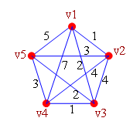
7.2.9 旅行商问题(Traveling Salesman Problem)
问题: 设一个由N个城市v₁,v₂,…v_{n}组成的网络, c_{i,j} 为从v_{i} 到v_{j}的代价不妨设c_{i,j} = c_{j,i ,}且c_{i,i}=∞ .一推销员要从某城市出发经过每城市一次且仅一次后返回出发地问如何选择路线使代价最小。
抽象描述:将城市以及之间的道路抽象为一个无向图G, G中每边的权值表示这段线路的代价. 问题转化为求一条最佳周游路线:从一点出发,经过每点一次且仅一次并返回原点,且该路线的总代价最小.
费用矩阵
C=
Notes:
200

Slide 201
7.2.9 旅行商问题(Traveling Salesman Problem)
求解 TSP 问题至少有两种贪心策略是合理的
  最近邻点策略
  从任意城市出发，每次在没有到过的城市中选择最近的一个，直到经过了所有的城市，最后回到出发城市。
  最短链接策略
  每次在整个图的范围内选择最短边加入到解集合 S 中，但是，要保证加入解集合中的边最终形成一个哈密顿回路。

Slide 202
TSP问题
C=
1
∞ 3 3 2 6
3 ∞ 7 3 2
3 7 ∞ 2 5
2 3 2 ∞ 3
6 2 5 3 ∞
6
3
1
5
2
3
2
5
2
2
3
3
4
3
4
3
2
(a) 5城市的代价矩阵 (b) 城市1→城市4 (c) 城市4→城市3
1
1
1
2
3
5
2
2
2
2
5
2
5
2
5
5
5
7
4
3
4
3
4
3
2
2
2
(d) 城市3→城市5 (e) 城市5→城市2 (f) 城市2→城市1
最近邻点贪心策略求解TSP问题的过程

Slide 203
TSP问题
C=
∞ 3 3 2 6
3 ∞ 7 3 2
3 7 ∞ 2 5
2 3 2 ∞ 3
6 2 5 3 ∞
1
1
2
2
5
2
2
5
2
4
3
4
3
(a) 5城市的代价矩阵 (b) 城市1→城市4 (c) 城市5→城市2
1
1
1
3
2
2
2
2
2
2
5
2
5
2
5
2
5
5
4
3
4
3
4
3
2
2
2
(d) 城市4→城市3 (e) 城市3→城市5 (f) 城市2回到出发城市1
最短链接贪心策略求解TSP问题的过程

Slide 204
TSP问题
[算法1]设图G 有 n 个顶点，边上的代价存储在二维数组w[n][n]中，集合V 存储图的顶点，集合 P 存储经过的边，最近邻点策略求解 TSP 问题的算法如下：
算法——最近邻点 策略求解 TSP 问题
1． P={ }; //对应解集合S
2． V=V-{u0}; u=u0; //从顶点u0 出发
3． 循环直到集合P 中包含 n-1 条边
3.1 找与顶点 u 邻接的最小代价边(u, v), 并且v属于集合V；
3.2 P=P+{(u, v)};
3.3 V=V-{v};
3.4 u=v; //从顶点v出发继续求解
伪代码

Slide 205
TSP问题
算法分析1
  时间复杂度
  算法的时间性能为O(n²)，因为共进行n-1次贪心选择，每一次选择都需要查找满足贪心条件的最短边。
  最优解讨论
  用最近邻点贪心策略求解TSP问题所得的结果不一定是最优解，示例中从城市1出发的最优解是:
      1→2→5→4→3→1
      代价：13
  当图中顶点个数较多并且各边的代价值分布比较均匀时，最近邻点策略可以给出较好的近似解，不过，这个近似解以何种程度近似于最优解，却难以保证。
    例如，示例中，如果增大边(2, 1)的代价，则总代价只好随之增加，没有选择的余地。

Slide 206
TSP问题
最短链接策略：
每次在整个图的范围内选择 (1) 最短边加入到解集合中，但是，要保证加入解集合中的 (2) 边最终形成一个哈密顿回路。因此，当从剩余边集 E‘中选择一条边 (u, v) 加入解集合S 中，应满足以下条件：
  边(u, v) 是边集 E‘ 中代价最小的边；
  边(u, v) 加入解集合S 后，S 中不产生回路；
  边(u, v) 加入解集合S 后，S 中不产生分枝；

Slide 207
TSP问题
设图G 有n 个顶点， w[n][n] 存储边上的代价，集合E‘存储是候选集合中未选取的边，集合P 存储经过的边，最短链接策略求解TSP 问题的算法如下：
算法——最短链接策略求解TSP问题
1．P={ };
2．E'=E; //候选集合，初始时为图中所有边
3．循环直到集合P中包含n-1条边
3.1 在E'中选取最短边(u, v);
3.2 E'=E'-{(u, v)};
3.3 如果 (顶点 u 和v 在 P 中不连通 and 不产生分枝)
则P=P+{(u, v)};
伪代码

Slide 208
TSP问题
时间复杂度讨论
  在算法中，如操作“在 E‘ 中选取最短边(u, v)”用顺序查找，则算法 的时间性能是O(n²)，
  如果采用堆排序的方法将集合 E‘ 中的边建立堆，则选取最短边的操作可以是 O(log₂n)，对于两个顶点是否连通以及是否会产生分枝，可以用并查集的操作将其时间性能提高到O(log₂n)，此时算法 的时间性能为O(nlog₂n)。

Slide 209
思考题-旅行商问题(货郎担问题)
首先在图中选一条代价最小的边。为了选择下一条边，先要检查一下候选边与已选入的边之间是否满足以下两点：
1)不会有三条边(候选边及已入选边)与同一顶点相关联。
2)不会使入选边形成回路，除非入选边的个数已等于图中的顶点总数。
在满足以上两点的候选边中，挑选最短的边作为入选边。如此做下去，直到得到一个经过所有顶点的回路。
最后求得的回路是1—2—5—3—4—1，代价是14。实际图1—1最小代价的回路是1—2—5—4—3一1，代价是10。

Slide 210
思考题-旅行商问题(货郎担问题)
输入:城市的数目n,代价矩阵c=c(1..n,1..n).
输出: 最小代价路线
1. tour:=0; // tour 纪录路线/
2. cost:=0; // cost 纪录到目前为止的花费/
3. v:=N; // N为起点城市, v为当前出发城市/
4. for k:=1 to N-1 do
5. { tour:= tour+(v,w) //(v,w)为从v到其余城市代价中值最小的边/
6. cost:= cost+c(v,w)
7 v:=w}
8 tour:= tour+(v,N)
9 cost:= cost+c(v,N)
print tour, cost
*该算法不能求的最优解.
算法的最坏时间复杂性为O(n²)
Notes:
210

Slide 211
Planning of schools
A collection of towns. We want to plan schools in towns.
  Each school should be in a town
  No one should have to travel more than 30 miles to reach one of them.
Edge: towns no far than 30 miles
Notes:
Nodes within 30 miles have an edge

Slide 212
Set cover
Input. A set of elements B, sets
Output. A selection of the S_{i} whose union is B.
Cost. Number of sets picked.

Slide 213
Greedy
Greedy: first choose a set that covers the largest number of elements.
  example: place a school at town a, since this covers the largest number of other towns.
Greedy #4
OPT #3

Slide 214
设数组color[n]表示顶点的着色情况，贪心法求解图着色问题的算法如下：
算法——图着色问题
1．color[1]=1; //顶点1 着颜色1
2．for (i=2; i<=n; i++) //其他所有顶点置未着色状态
color[i]=0;
3．k=0;
4．循环直到所有顶点均着色
4.1 k++; //取下一个颜色
4.2 //用颜色 k 为尽量多的顶点着色
for (i=2; i<=n; i++)
4.2.1 if 顶点 i 已着色，则转步骤 4.2，考虑下一个顶点;
4.2.2 if 图中与顶点 i 邻接的顶点着色与顶点i 着色 k 不冲突，
则 color[i]=k;
5．输出 k;
伪代码
算法的时间复杂性是O(k*n)

Slide 215
一个双向图的着色问题
考虑一个有2n个顶点的无向图，顶点编号：1~2n
当i是奇数时，顶点i与除了顶点i+1之外的其他所有编号为偶数的顶点邻接，
当i 是偶数时，顶点i与除了顶点i-1之外的其他所有编号为奇数的顶点邻接，这样的图称为二部图（Bipartite）。
奇数i
1
3
5
7
i-1
i+1
偶数i
2
4
6
8
图 具有8个顶点的双向图

Slide 216
一个双向图的着色问题
讨论
  可以将奇数顶点全部着颜色1，偶数顶点全部着颜色2；
  若贪心法以1,3,…,2n-1, 2,4,…,2n的顺序为双向图着色，则算法可以得到最优解：2种颜色；
  若贪心法以1,2，3,…,n 的顺序为双向图着色，则算法需要 n/2 种颜色。

Slide 217
练习
1、N个顾客等待同时等待一项服务，顾客i需要的服务时间是t_{i},如何安排使所有顾客总的等待时间最短？
若有S处提供同一服务，又该如何安排顾客服务次序？

Slide 218
练习
2、通过键盘输入一个高精度的正整数n (n的有效位数≤240)，去掉其中任意s个数字后，剩下的数字按原左右次序将组成一个新的正整数。编程对给定的n 和s，寻找一种方案，使得剩下的数字组成的新数最小。
【样例输入】
178543
S=4
【样例输出】
13

Slide 219
练习分析
贪心策略：每一步总是选择一个使剩下的数最小的数字删去。
（1）按高位到低位的顺序搜索，删除首个上升子序列的末字符。
（2）回到串首，按上述规则再删除下一个数字。
（3）重复以上过程s次，剩下的数字串便是问题的解了。
【样例输入】
178543
S=4
【过程】
178543
17543
1543
143
13

Slide 220
练习分析
delete（n ,s)
{输入s, n;
while（ s > 0 ）
{ i=1; //从串首开始找
while (i<length(n))&&(n[i]<n[i+1])
i++;
delete(n,i); //删除串n的第i个字符
s--;
}
while (length(n)>1)&& (n[1]=‘0’)
delete(n,1); //删去串首可能产生的无用零
输出n;
}
贪心策略：每一步总是选择一个使剩下的数最小的数字删去。
（1）按高位到低位的顺序搜索，删除首个上升子序列的末字符。
（2）回到串首，按上述规则再删除下一个数字。
（3）重复以上过程s次，剩下的数字串便是问题的解了。

Slide 221
A Simple Example
Problem: Pick k numbers out of n numbers such that the sum of these k numbers is the largest.
Algorithm:
    FOR i = 1 to k
    Pick out the largest number and
    delete this number from the input.
    ENDFOR
N位数删除K个数字，使剩下的数字串最小
给出一个n位数，要求删掉其中k位数字，使得剩下的数字组成的数尽量大。

Slide 222
Done Greedy

